Slide 1
Finance Department
Sheldon Jantz, Finance Manager 719-538-4923 finance@isionline.org
Lisa Robinson, Staff Accountant 719-538-4915 srobinson@isionline.org
Christine Holland, Min Adv Coord 719-538-492 reimbursements@isionline.org
HTTPS://FINANCEISI.WEEBLY.COM
www.Paycomonline.com

Slide 2

Reports

Slide 3
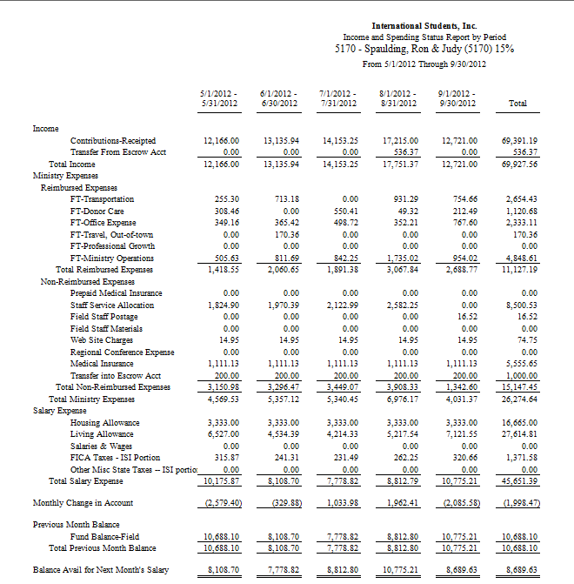
3200 Finance Department (3200)

Slide 4

How to Read the Statement of Cash Flows Report
Adds beginning balance to the activity for the current month to arrive at ending balance.
Displays all sources of income:
    Receipted Income
    Stock Gifts
    Miscellaneous Income
    Interfund Transfers In
Staff Service Allocation Deduction

Slide 5
Deductions:
  Ministry Expenses:
    Transportation
    Donor Care
    Office Expense
    Etc.
  Home Office Charges for materials, postage, etc.
  Housing Allowance
  Living Allowance
  National Staff Conference Escrow
New Ending Fund Balance

Slide 6
Questions?????

Slide 7
Field Staff Income Report
This report is sent to you, your RFD, and your Partnership Development (PD) coach.
Shows you what your budget is compared with your monthly and YTD income.
Gives you your support level %, so you know where you are in reference to the 100% plus program.

Slide 8
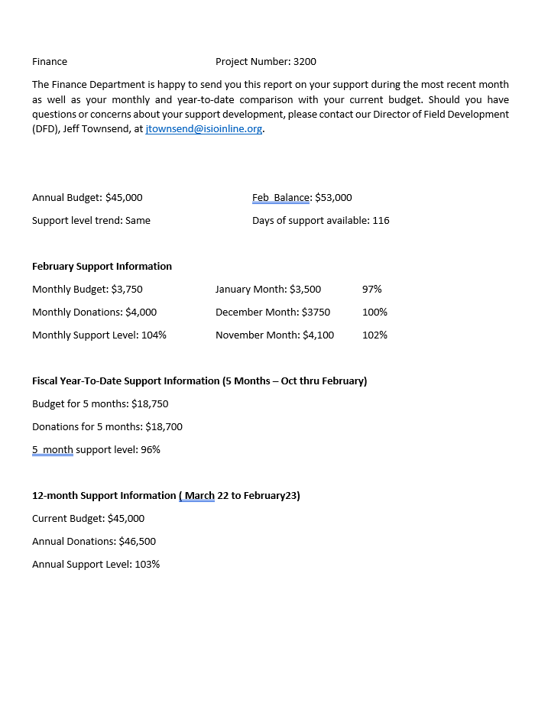


Slide 9
Questions?????

Slide 10
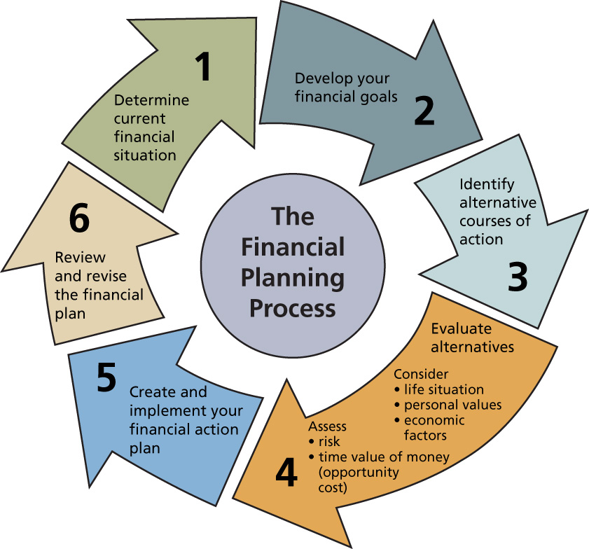
Budgets

Slide 11

Budget Worksheets
Work with your Regional Field Director (RFD) to complete the budget worksheet.
If you are commissioned, licensed or ordained minister, then you are eligible for a housing allowance.
Housing allowances need to be approved by the ISI Board of Directors. Doug Shaw has interim approval authorization.
Generally, changes may be made to your budget only during the annual budgeting process.

Slide 12
Budget Worksheets
Salary split between Housing/Living
FICA
Ministry Expenses
Escrow
Staff Service Allocation
Total Amount to Raise

Slide 13
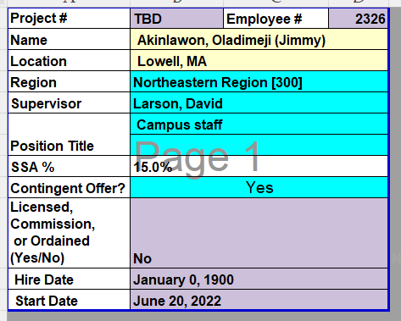

Slide 14
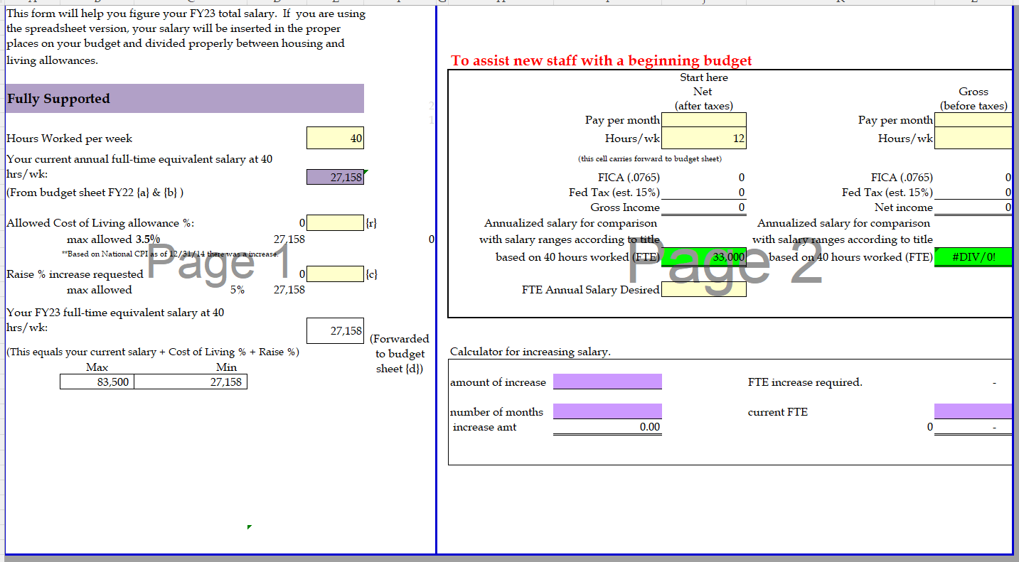

Slide 16
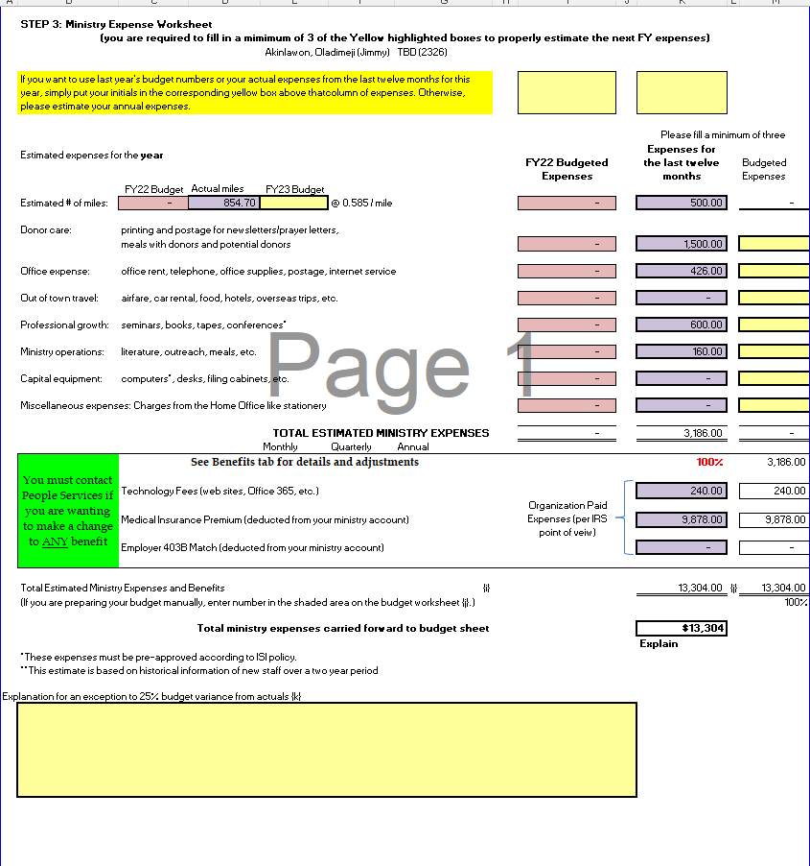

Slide 17
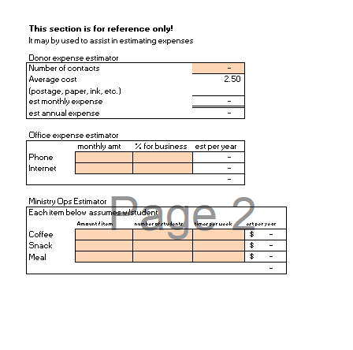

Slide 18
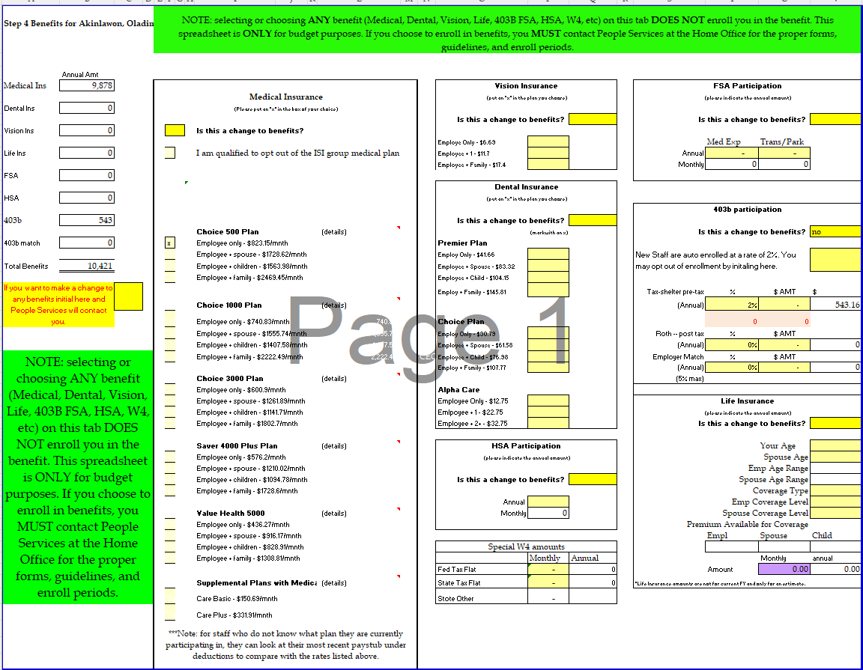

Slide 19
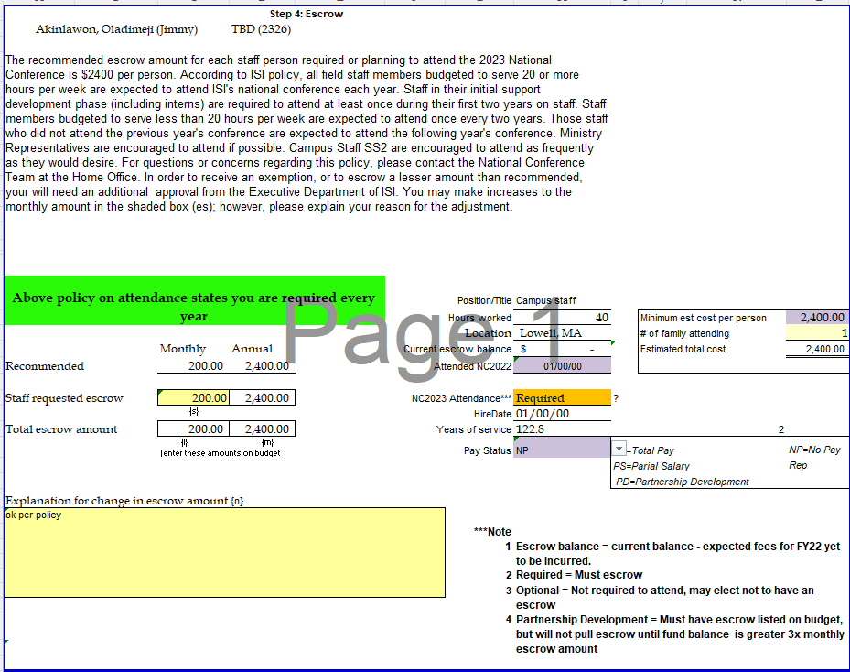

Slide 20
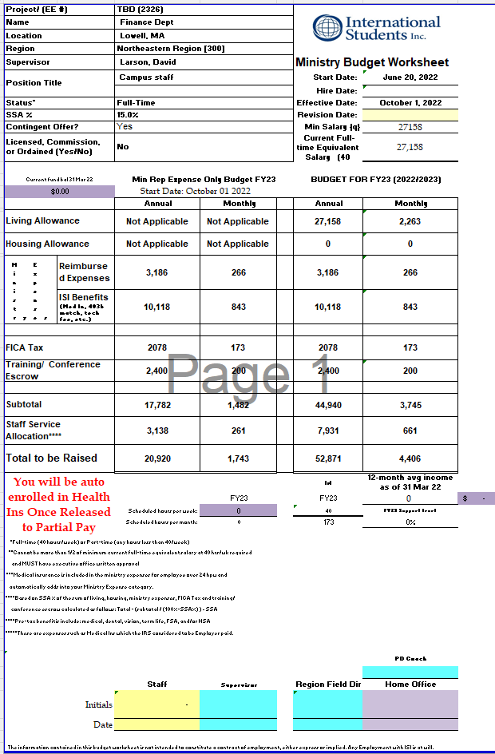

Slide 21
Questions?????

Slide 22

Payroll
Payroll

Slide 23

When will I be paid?
Payroll is paid once each month on the 15th for salaried field staff.
  Pay for current month’s work, 1st - 31st
For hourly staff, the payroll is on the 15th and the last day of the month.
If the 15th or the last day of the month falls on a weekend or holiday, payday is on the last business day prior to those dates.

Slide 24
When do I start receiving a paycheck?
When a new employee starts with ISI, they are put on what is called Partnership Development (PD). That means they do not actually work full-time with students, but are actively engaged in raising support and a donor base. Each employee works closely with one of our PD coaches until they are at 100+% support level or 2 yrs has passed. As the employee raises their support level, the PD coach will notify the Finance Department to start paying a percentage of their budgeted salary until they reach a support level that enables them to be fully paid.
Once an employee is released to receive Partial Salary (PS) paychecks, we will start tracking shortages in salary.

Slide 25

How will I be paid?
Check or Direct Deposit
  Direct Deposit is the preferred method
  ISI provides an electronic paystub by logging onto the Payroll system with your unique login. You will receive this login information from People Services. The Payroll website is: https://login.paylocity.com
  Checks are mailed to arrive, hopefully, by the pay date.

Slide 26

How is payroll calculated?
Pay for a particular month is based on your fund balance at the end of the prior month.
The Finance Team calculates your ending fund balance for the prior month. (How?)
Short pay (underpaid compared to budget)
Back pay (Short pay actually paid out)
  Allowed two full years to raise back pay before you lose it.
Married couples - Both work for ISI

Slide 27

Payroll Calculations
Your gross pay will be the lesser of your budgeted salary or your fund balance at the end of the prior month.
ISI sponsored, pre-tax dental, vision, life premiums, and FSA/HSA amounts
Housing Allowance is paid first.
  May be lessened if participating in the above plans
Living Allowance is paid next.
  The Housing and/or Living Allowance, which we pay you is based upon your submitted and approved annual budget.

Slide 28
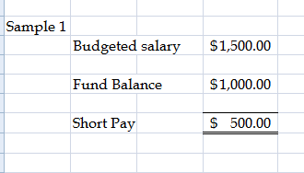
How Payroll is Calculated

Slide 29
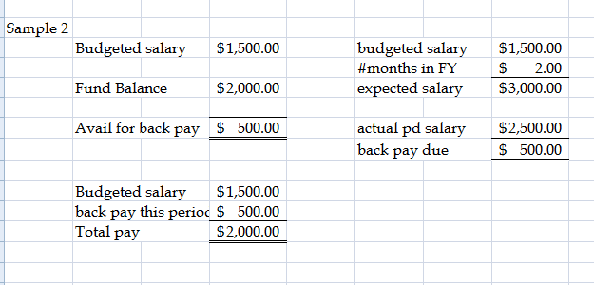
How Payroll is Calculated

Slide 30
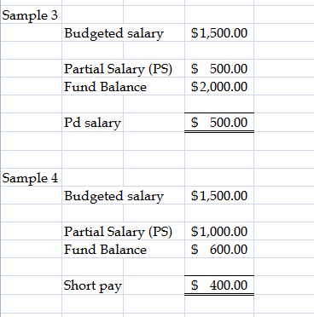
How Payroll is Calculated

Slide 31

Flexible Spending Account (FSA)
Pre-tax voluntary deduction
Administered by 3rd party
Medical expenses
Non-employer Sponsored Insurance Premiums
Qualified transportation expenses
Dependent Day Care
  Additional information in your handouts

Slide 32

Health Savings Account (HSA)
Pre-tax voluntary deduction
Administered by 3rd party
Medical expenses
Requires that you are enrolled in a High Deductible High Premium (HDHP) insurance plan
Grows from year to year [don’t lose it]

Slide 33

Retirement Savings Plan
403(b)
  Guidestone Financial
  Roth Option
  Matching funds
  Auto Enrollment
  Auto Escallation

Slide 34



Other payroll deductions
Term Life Insurance
Vision
Dental

Slide 35

PAYROLL TAXES
Please note, the following is general information. We do not have the expertise or all your personal information to provide tax advice or prepare your taxes.

Slide 36
PAYROLL TAXES
ISI withholds Federal Income Taxes on the taxable portion of your income. The payroll department is required to have a completed W-4 on file to properly withhold Federal Income Taxes.
We do not have employees in AK, AL, DC, DE, ND, NH, OH, OK, RI, VT, WI, WV, & WY

Slide 37
PAYROLL TAXES
FICA (Federal Insured Contribution Act) is withheld from the employee’s pay and is matched by the employer (from funds in your ministry account).

Slide 38

Commissioned, Licensed or Ordained Ministers
Ministers are considered self-employed in regards to social security.
  They are covered by the Self Employment Contributions Act (SECA).
  We are not allowed to withhold FICA or match it with the employer’s share.
  Additional federal taxes may be withheld to cover the minister’s self employment tax liability (SECA).

Slide 39
  SECA applies to both Housing and Living.
  The full SECA rate is 15.3%, but the effective rate does fluctuate slightly based on your tax bracket.
Ministerial services are subject to self-employment tax unless:
  The minister is a member of a religious order, whose members have taken a vow of poverty, or
  The minister has requested, and the IRS has approved an exemption from self-employment tax.

Slide 40
Other Minister Tax Rules
Ministers are eligible for a Housing Allowance.
  The amount that you spend to maintain a household, subject to limitations, is exempt from Federal Income Taxes.
Ministers can claim exemption from withholding (but not from PAYING) Federal Taxes.

