Slide 1
STEP 6
Requesting an Appointment
Where the battle begins!

Slide 2
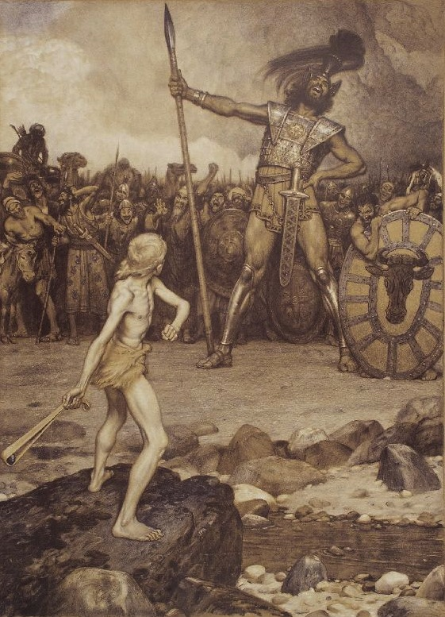
This feels a lot like David and Goliath!
David’s confidence was in God (1 Samuel 17:26, 37, 45).
David ran toward Goliath in that confidence (1 Samuel 17:48).
We must do the same when requesting an ‘ask’ appointment.
So begin with prayer and keep trusting!

Slide 3
Carefully Consider Generational Differences
“Seek to discover and utilize the most effective way to connect with your potential supporters in order to set up an appointment.” -The God Ask, p. 186
For younger folks, use texts or social media.
For older folks, phone or Facebook may be best.

Slide 4
Suggestions from The God Ask Chapter 22
Use discernment when to make contact.
Offer a couple of times to meet, with flexibility.
Determine the place to meet based on the person.
Outline your script and have it in front of you.
You want to share ministry vision and financial goals.

Slide 5
What if someone will not meet?
Carefully attempt to discern the reason.
Ask if you can add/keep them on your update list.
Ask if you can re-contact them at a future time.
Always thank them!
REMEMBER: ‘No’ is seldom final!

