Slide 1
Step 3 Record-keeping
Keeping track of your PD

Slide 2
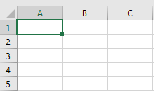
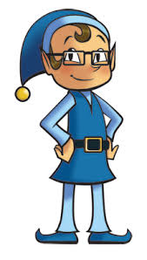
Excel spreadsheet: find on O365
TntWare: https://www.tntware.com/
DonorElf: https://www.donorelf.com/

Slide 3
STEP 4 Identifying Prospects
Your Personal Contact List (PCL)

Slide 4
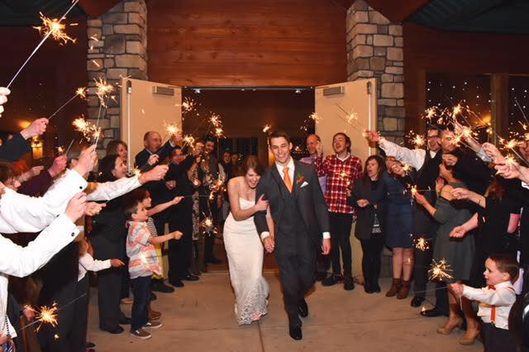
“Have as large a wedding as possible. You’ll never know when it will come in handy!” --The God Ask (p. 152)

Slide 5
‘Namestorming’ Steps:
Pray, asking God to help you remember.
Write down everyone you can possibly think of that you have ever known or met.
There are no bad names…at least initially.
The average person has about 1,000 friends and acquaintances.
But the average person has kept up with only 60 of those.

Slide 6
‘Namestorming’ Ideas:
Yearbooks
Wedding invitation lists
Christmas card lists
Church directories
Accumulated pictures
Facebook friends
Cell phone contacts
Outlook contacts

Slide 7
Finding info on old contacts
The God Ask, p. 332
AnyWho.com
ZabaSearch.com
Google Maps

Slide 8
Organizing
Segmenting your PCL:
A LIST*: ASK to partner in the vision
B LIST: BRING awareness of the vision
C LIST: CONNECT with acquaintances
D LIST: DONORS on-board with the vision
*Triple A LIST: people willing to let you practice your ask with them

