Slide 1
Reaching International students in Sacramento and training new staff nationally

Slide 2
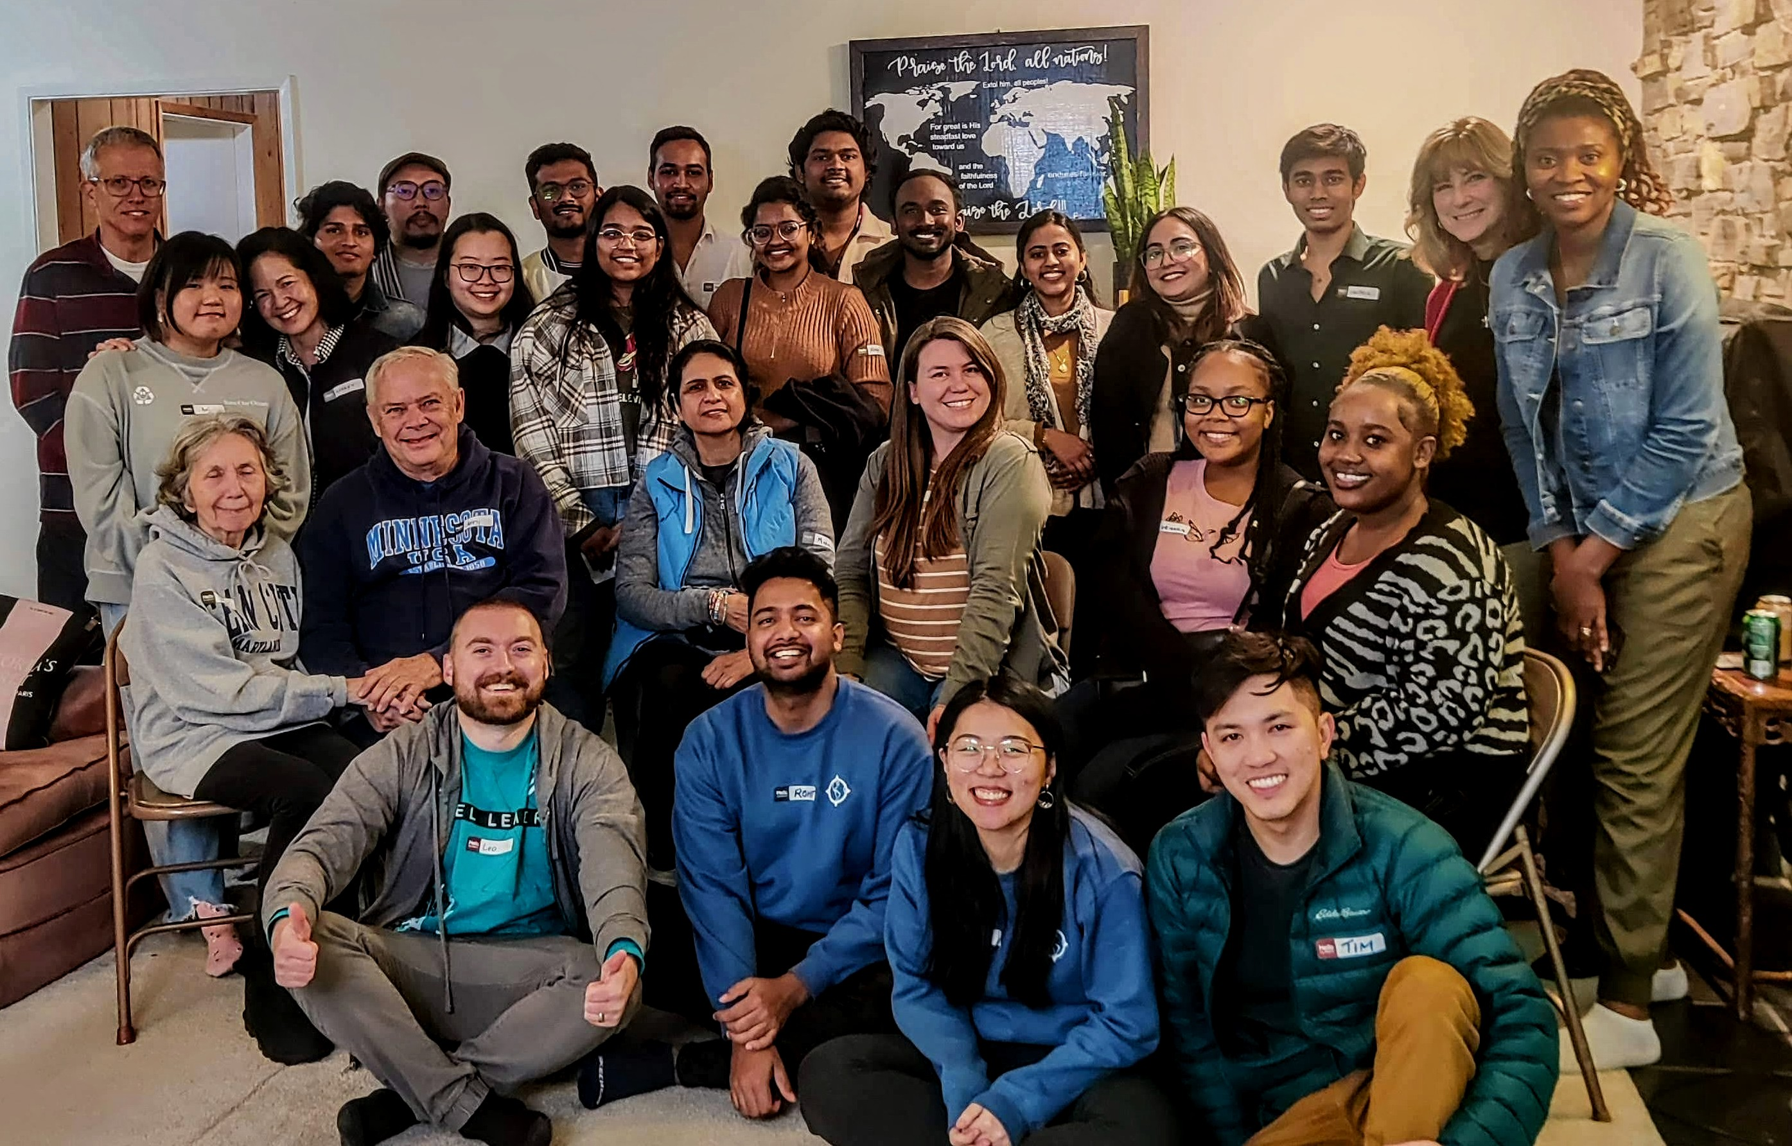
INTERNATIONAL STUDENTS, INC. EXISTS TO SHARE CHRIST'S LOVE WITH INTERNATIONAL STUDENTS AND TO EQUIP THEM FOR EFFECTIVE SERVICE IN COOPERATION WITH THE LOCAL CHURCH AND OTHERS.

Slide 3
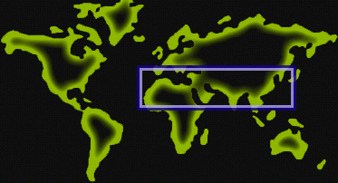
The Need
The majority of people in the world who have not heard the gospel are from the 10/40 Window.*
Many of the international students in the U.S. come from these gospel-resistant countries.
*The area that lies across Africa and Asia from 10 degrees latitude North of the equator to 40 degrees latitude North of the equator.​

Slide 5
International students are often isolated and overwhelmed by the pressures of life in America.
They are especially open to Christians who love them and share the gospel with them.

Slide 8
Missions in reverse
The world is at our door!
international students to Christ
them in their faith
Win
Build
them out to reach others
Send

Slide 9
ISI statistics for the 2022-23 school year
499 decisions for Christ
3,512 students being discipled
299 students reproducing overseas
470 students reproducing in the US

Slide 10
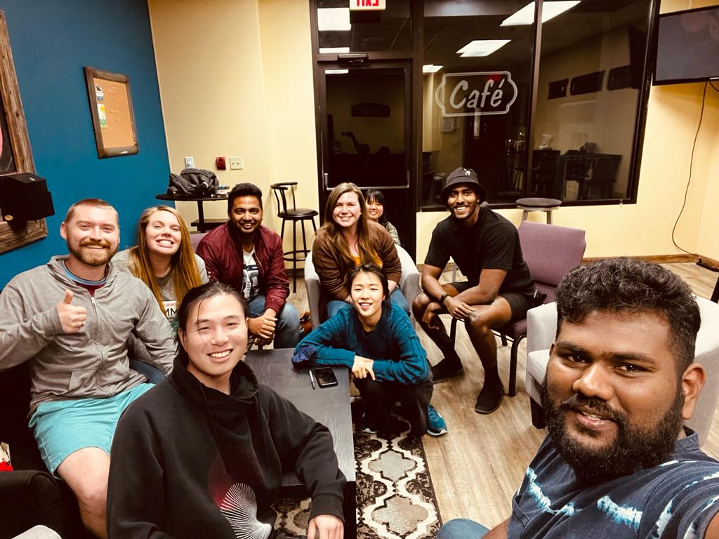
iLife
What we do
Meet new students
Fun events
Bible study
Discipleship and serving

Slide 11
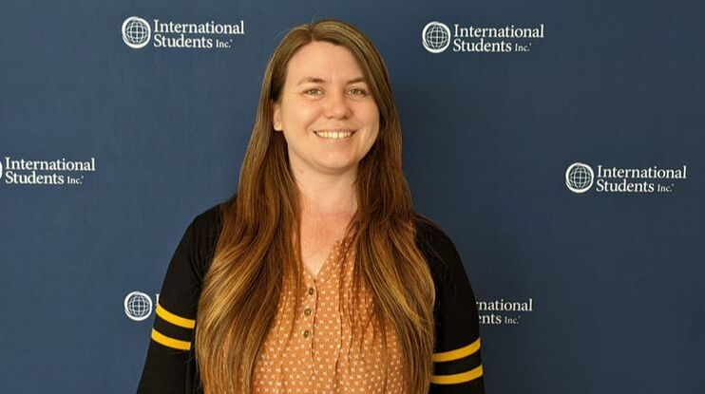
New position at national level of isi
Coordinator of
field development
I will be working with Jeff Townsend, Director of Field Development, to train new staff and support them through the Partnership Development (support raising) process.
Our goal is to get new staff on the field as soon as possible so that they can reach more international students for Jesus.

Slide 12
How you can help
ISI has no central funds.
Like many mission organizations, we depend upon the financial support of individuals and churches.
These contributions are used for salary, benefits, and ministry expenses.
I need a team of partners who will donate to ISI monthly to make this possible.
Will you prayerfully consider
joining my team?

Slide 13
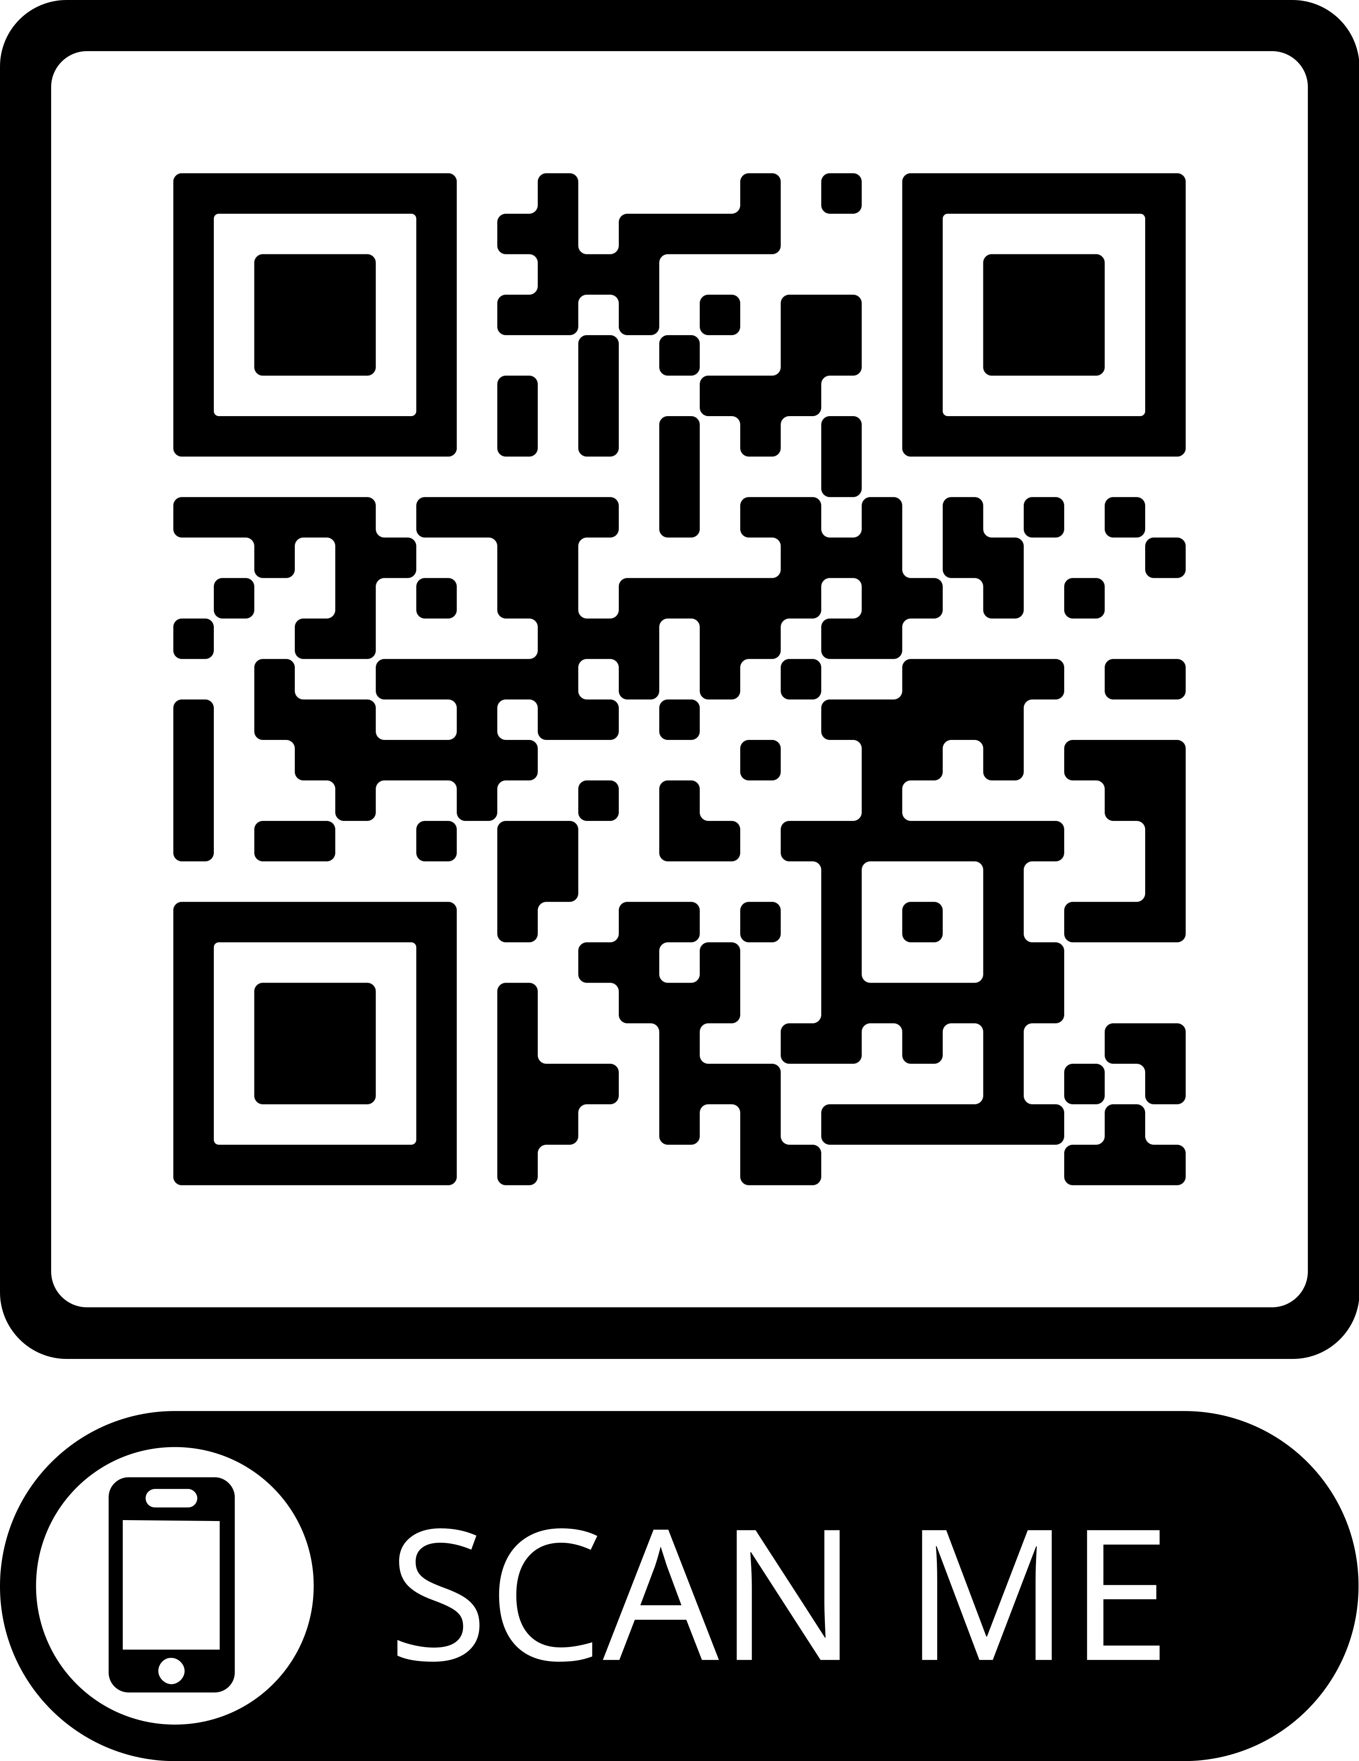
Thank You
Amber Carpenter
(916)995-5923
acarpenter@isionline.org
ambercarpenterisi.weebly.com

