Slide 1
Organizational & Management Structures
November 2023
Alex Tovar
Director of Operations

Slide 2
Directors
Board of Trustees
(ensures financial viability and fulfillment of ISI’s mission)
Seng Tan
President/CEO
Regional Field Directors
(manage and provide pastoral care for staff members in their region)
Tim Sigman
Director of Prayer Initiatives
Gordy Decker
Director of Coaching & Mentoring
Teri Crowell
Director of
Recruitment (part-time)/
Assistant
Training
Director
(part time)*
(recruiting and oversight of applications for field ministry)
Alex Tovar
Director of
Operations
(oversees operations of the ministry including finance, personnel, insurance, employee benefits, IT, special projects, etc.)
Valerie Althouse
Director of
Training
(develops and delivers ISI-specific training for staff, ministry partners, and students)
Jeff Townsend
Director of Field Development
(train, coaches, and monitors Partnership Development of field team members who raise support)
David Larson
Regional Field Director
(Northeast Region) & Director of Global Reach
Dan Lim
Director of Innovation and Research
Roy Yabuki
Regional Field Director
(Rocky Mt. /Plains Region)
Andy Pearce
Director of Church Partnerships
Ed Germann
Regional Field Director
(Southeast/Great Lakes Region)
Simon Zeigler
Regional Field Director
(Western Region)
Roger Martin
Global Pastor
*Also serves as City Director Phoenix Revised 2/2022

Slide 3
Board of Trustees
Mr. Keith Jordan
Mr. Steve Prensner
(Chair)
Mr. John Stumbo
Dr. Seng Tan
(President/CEO)
Mr. Mark Waters
Mr. Silas Wong

Slide 4
ISI is a Church!
ISI is duly registered and established as a church under US tax laws.
This allows ISI to receive charitable, tax-deductible gifts for ministry.
More importantly, this allows ISI to fulfill our mission to reach every international student with the Love of Christ, and
Allows ISI to commission our team members to perform sacerdotal duties (baptisms, weddings, funerals, and administering of Holy Communion).

Slide 5
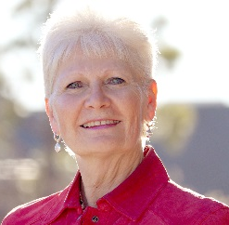
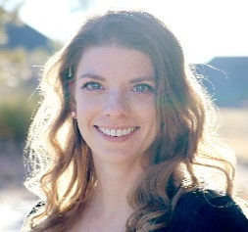
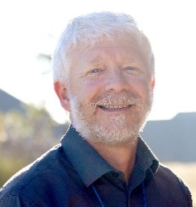
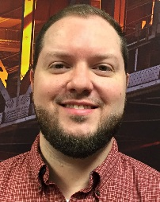
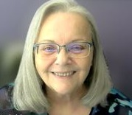
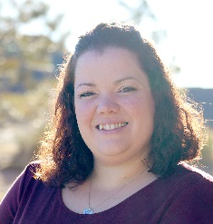
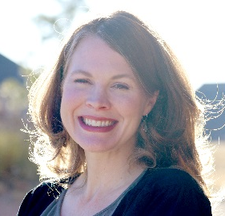
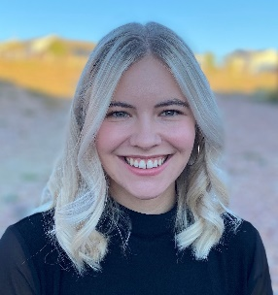
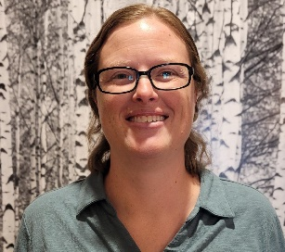
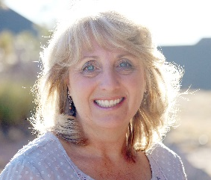
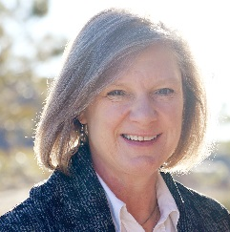
ISI Operations Team
Ministry Advancement
Finance
Christine
Jennifer M.
Sheldon
Lisa
Ministry Operations
Publications/Websites
Jonathan
Mickie
Rebekah
Breanne
People Services
Samantha
Emily
Teresa
Jennifer L.

Slide 7
What We Believe
Mission Statement:
International Students, Inc. exists to share Christ's love with international students and to equip them for effective service in cooperation with the local church and others.
Core Values:
Christ-centered approach to serving others
Student-centered ministry
Full-cycle evangelism
Dependence on churches
National identity
Statement of Faith and Biblical Principles:
Final Authority: the Bible speaks with final authority concerning truth, morality, and conduct
Marriage: the uniting of one man and one woman in a single exclusive union (Gen 2:18-25)
Gender: God wonderfully and immutably creates each person as male or female that reflect the image of God (Gen 1:26-17)
Sexuality: God intends sexual intimacy to occur between a man and woman who are married to each other (1 Cor 6:18)
Sanctity of Life: we are called to defend, protect, and value all human life (Ps 139)

Slide 8
Ministry Operations
www.isiministryoperations.org
Legal & Insurance
Contracts
Liability insurance
Social Media Policy
Music/Video Use
Student Event Photos
Overseas Trips
Reporting

Slide 9
Questions?

