Slide 1


Slide 2
Computers

Slide 3
Office365
ISI Staff and Ministry Reps will have the option to use O365
AND the ability to download Microsoft Office to 5 devices.

Slide 4
Multi-Factor Authentication
What do I do?
  Step 1: Download and install MICROSOFT AUTHENTICATOR app
  Step 2: Add your account to the App and follow the prompts.
  Step 3: Change the default sign-in method to the Authenticator App.
  If you run into trouble, let me know!

Slide 5
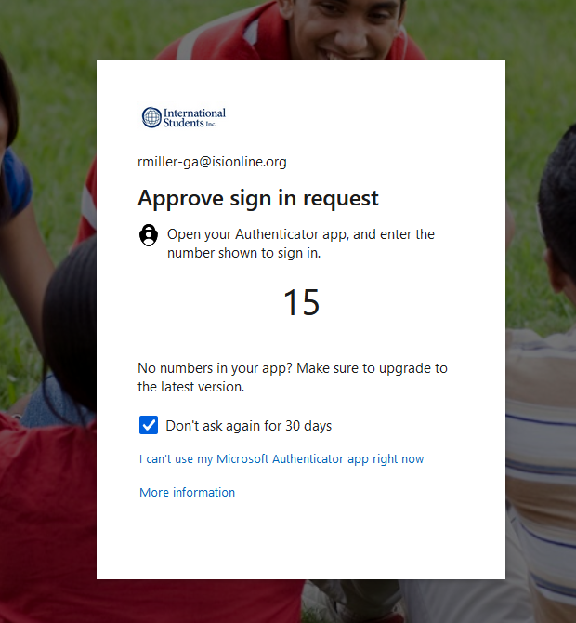
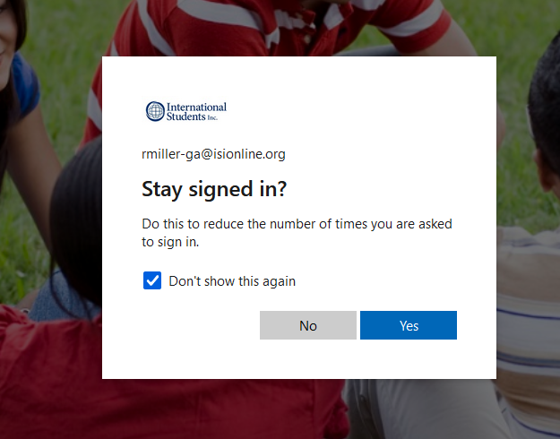

Slide 6
ISI email
firstinitiallastname@isionline.org
How to access your ISI email:
  3 options:
    Use web portal – www.office.com
    Use your mobile device
      Set it up as EXCHANGE.
      The server is: outlook.office365.com
    Use Outlook

Slide 7

Web portal: www.office.com
Use your isionline.org email to log in
  Unsure of your password? Contact Rebekah to have your
  password reset.
  How to change your password

Slide 8
Purchasing a computer:
Contact your RFD for approval
Make sure you have funds in your account
Go shopping!
Have the salesperson or Rebekah sign off
Submit for reimbursement (along with the approval from Rebekah or the salesperson)
www.ISITeam.org (pw: ISIJohn316)

Slide 9
Field Staff Computer
Minimum Requirements and Recommendations
Intel® Core™ i5 Processor, or AMD equivalent CPU
8 GB Windows 11
500 GB Hard Drive/250 GB SSD Hard Drive (highly encourage MORE)

Slide 10
Field Staff Computer
Minimum Requirements and Recommendations
We HIGHLY recommend PCs for compatibility! If you desire to have a Mac, you will need to use Microsoft Office for Macs.
Some type of backup strategy (external hard drive, USB flash/jump/thumb drive, or online back up solution, etc.)
Some type of Anti-Virus protection, updated at least weekly (CRITICAL; MUST HAVE!). Also need firewall and anti-spyware program.

Slide 11
Field Staff Computer
Minimum Requirements and Recommendations
We recommend you use a reputable vendor (Dell, Gateway, Compaq/Hewlett Packard, etc.)
Support Contract: We recommend at least a minimum of 1-year warranty for desktops. For laptops, we recommend a 3-year warranty on the support agreement.

Slide 12
Computer Support
We strongly encourage field staff to have a computer person
to help with your computer needs

Slide 13
Social media:
ISI is on Facebook! (International Students)
https://www.facebook.com//InternationalStudentsInc

Slide 14
Media releases
If you plan to use a photo (or video) of a specific student, or group of students, who will be identified by name, a media release is required.

Slide 15
Can we post photos of students on social media?
  Yes, with the following guidelines:
    You provide notice that photos will be taken at the event in advance.
    Assign a specific ISI team member or volunteer to take official event photos and that only those pictures are posted online.
    Group photos may be posted as long as you do not identify individuals by name.
    If a student or other individual requests that their picture not be used, or that it be removed, you must comply with their request immediately.
    Never post pictures of minors unless parents give specific written permission via a media release form.

Slide 16
Can I “tag” students in our Facebook posts?
  NO. ISI team members may not “tag” students in photos unless a media release has been obtained by those students you wish to “tag.”
  International students, however, may “tag” each other.
  If you have questions or concerns about Media Releases, please contact Rebekah Miller, rmiller@isionline.org.

Slide 17
What are some other best practices?
Refrain from posting photos of students whom you specifically
know may face a significant security risk.
Immediately remove photos of students who request their photos
not be used.
If you have questions or concerns, contact Rebekah Miller at rmiller@isionline.org

Slide 19
Websites

Slide 20
Websites:
National website - www.internationalstudents.org
    Audience: Donors, volunteers, churches, students (general)
        Each staff and ministry representative will have a profile page and a direct donation link.

Slide 21
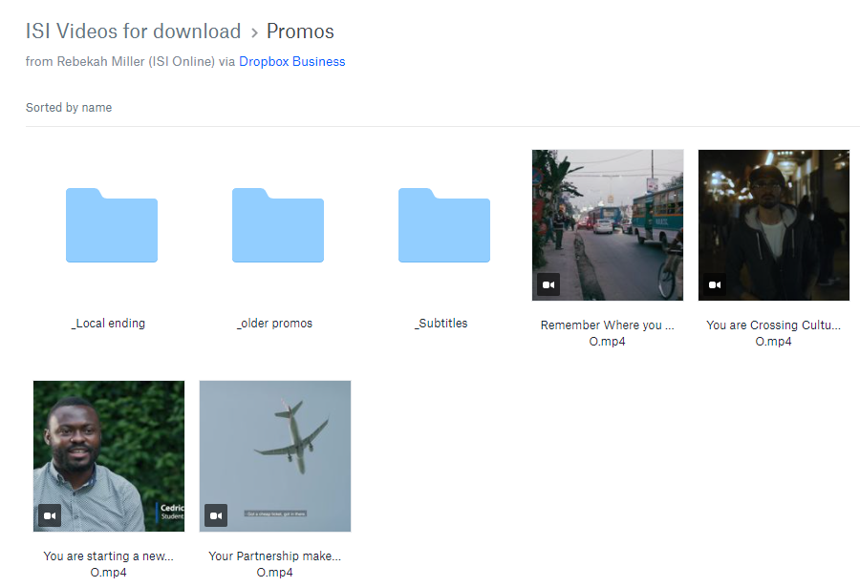
Websites:
ISI Team site – www.isiteam.org Password: ISIJohn316

Slide 22
RightNow Media
Offers over 20,000 resources for your encouragement, personal growth, and team training.
www.rightnowmedia.com

Slide 23
Weebly
You will have an opportunity to have a website!
You may use your site for students or volunteers!
Please keep the ISI logo visible, as well as the Privacy Policy
If you would like a friendly URL, contact Rebekah

Slide 24
Tech fee
Each ISI team member is charged $19.95/month for the Tech Fee
The tech fee covers:
  Office365
  ISI email
  Online giving
  Donation reporting
  Event registrations
  RightNow Media
  Weebly site

Slide 25
Resources

Slide 26
Materials
To place an order:
    orders@isionline.org
    1-800-474-4147 ext. 111
    Online store
      If you order at the online store,
      enter ISI STAFF in the coupon code for your discount.

Slide 27
Material Info:
Can charge it your account
When ordering Free Materials, you pay for shipping

Slide 28



ISI Displays:
To order, orders@isionline.org

Slide 29
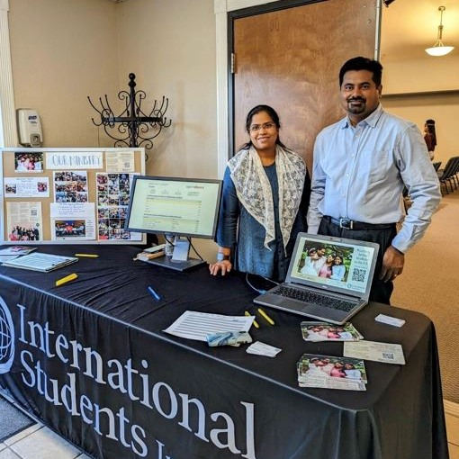
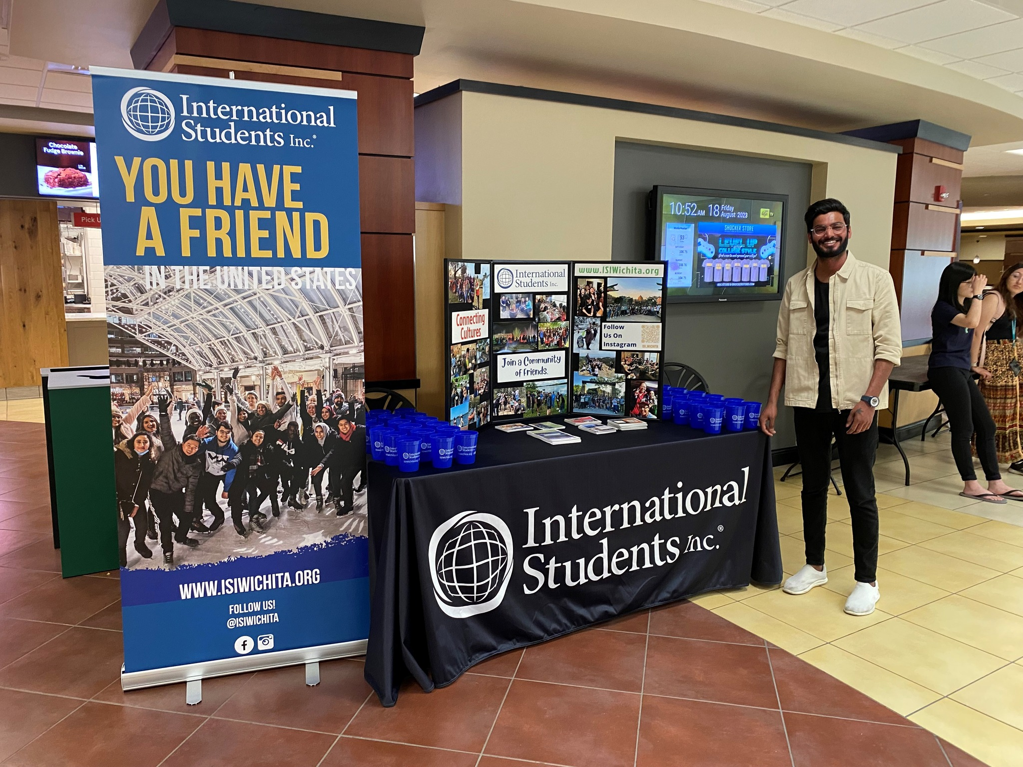

Slide 30
ISI Name badges:
To order, contact orders@isionline.org

Slide 31
Stationery:
Stationery must be printed by ISI
Orders are placed quarterly and must be in writing
Charged to your ISI ministry account
For special circumstances, you have the option to omit the
“Sharing Christ’s love…” tag
Contact Rebekah – rmiller@isionline.org

