Slide 1
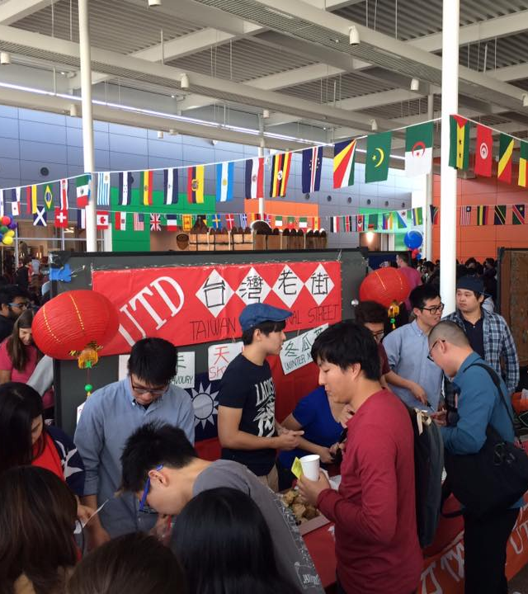
Reaching the world At our doorstep

Slide 2
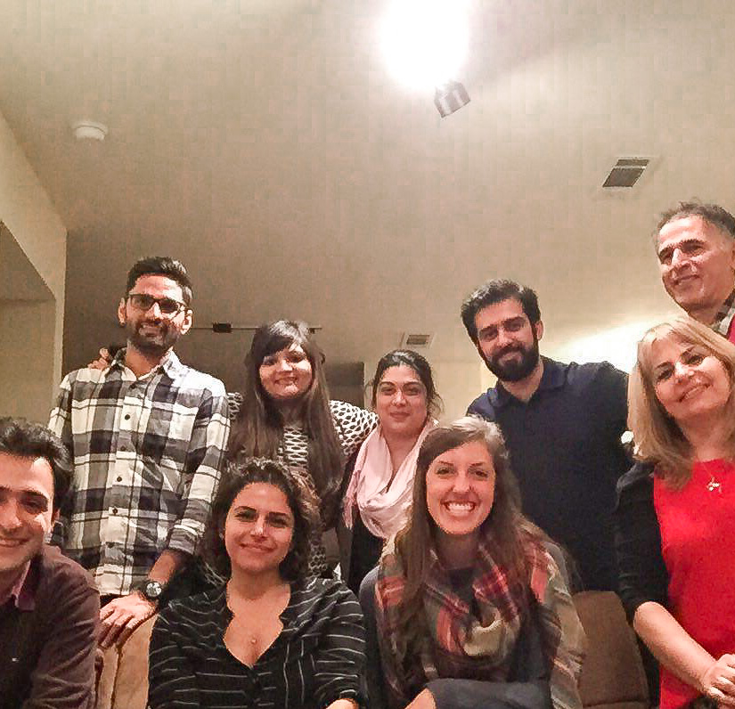
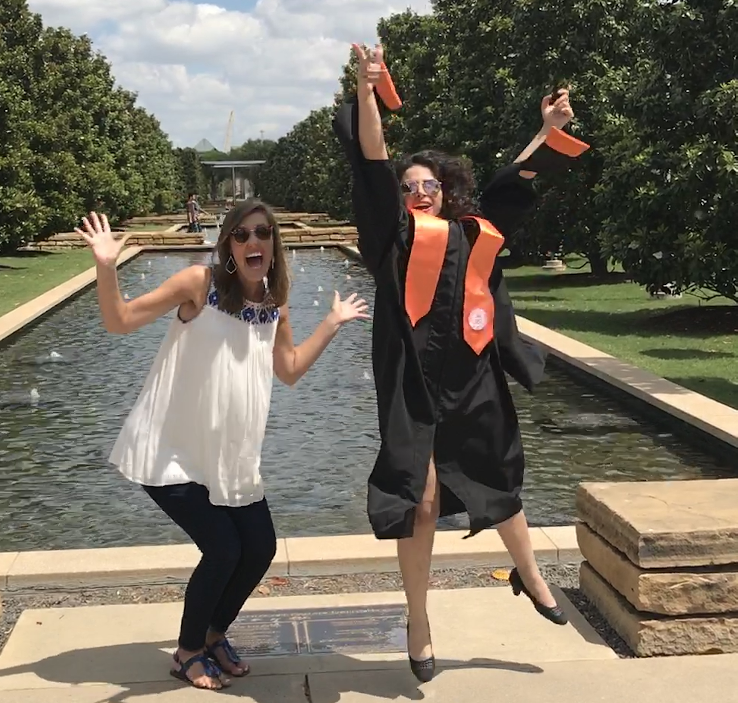
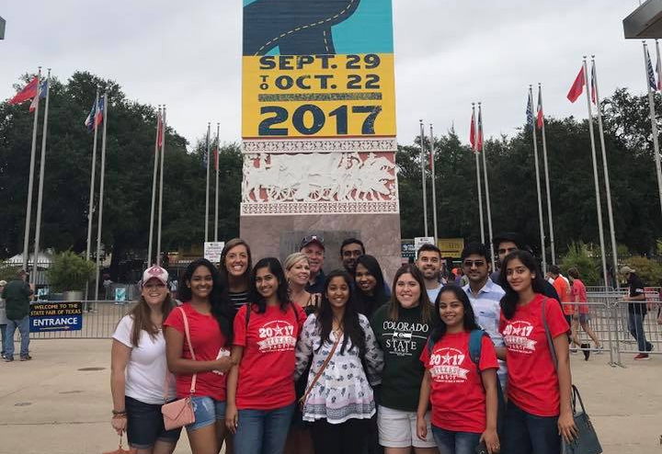
My Journey to ISI

Slide 3
Did you know?
1,075,496 international students study in the US
About 60% of international students come from restricted access countries
75% of international students never step foot in an American home while in US
80% of international students will never enter a church while in the US
Sources: Open Doors 2019/2020; International Students, Inc. internal data

Slide 4
History of isi
1945
World War II ends
Many parachurch ministries begin (Navigators, Cru, InterVarsity, etc.)
1948-49
In 1948, The seed for international student ministry is planted in Bob Finley’s heart.
1951-53
In 1951, Dawson Trotman asks Bob what he’d done with this seed.
The next year, the Navigators founder, Dawson Trotman, waters this seed.
In 1953, ISI’s ministry was officially established.
His response? “Nothing.” This is the catalyst God uses to move Bob Finley to establish ISI.

Slide 5
Mission statement
ISI exists to share Christ’s love with international students and to equip them for effective service in cooperation with the local church and others.

Slide 6
ISI’S MINISTRY MODEL
Traditional Missions: Send people from the US to other countries for short-, mid-, or long-term ministry
ISI’s Ministry: Reach the international students God is bringing to our country
ISI’s Goal: Lead these future leaders to Christ, disciple them, and send them back to their home country as a missionaries among their own people
This Photo by Unknown Author is licensed under CC BY-SA
This Photo by Unknown Author is licensed under CC BY-SA
This Photo by Unknown Author is licensed under CC BY-SA

Slide 7
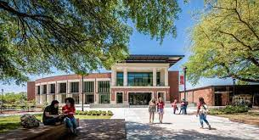
My role
Campus Staff to Lamar University
Develop & implement a strategy to reach and disciple international students with the Gospel
Train & equip volunteers from local churches to participate in this ministry
Build relationships with International Student Advisor & Lamar staff
*Approximately 850 international students go to Lamar, representing at least 55 countries

Slide 8
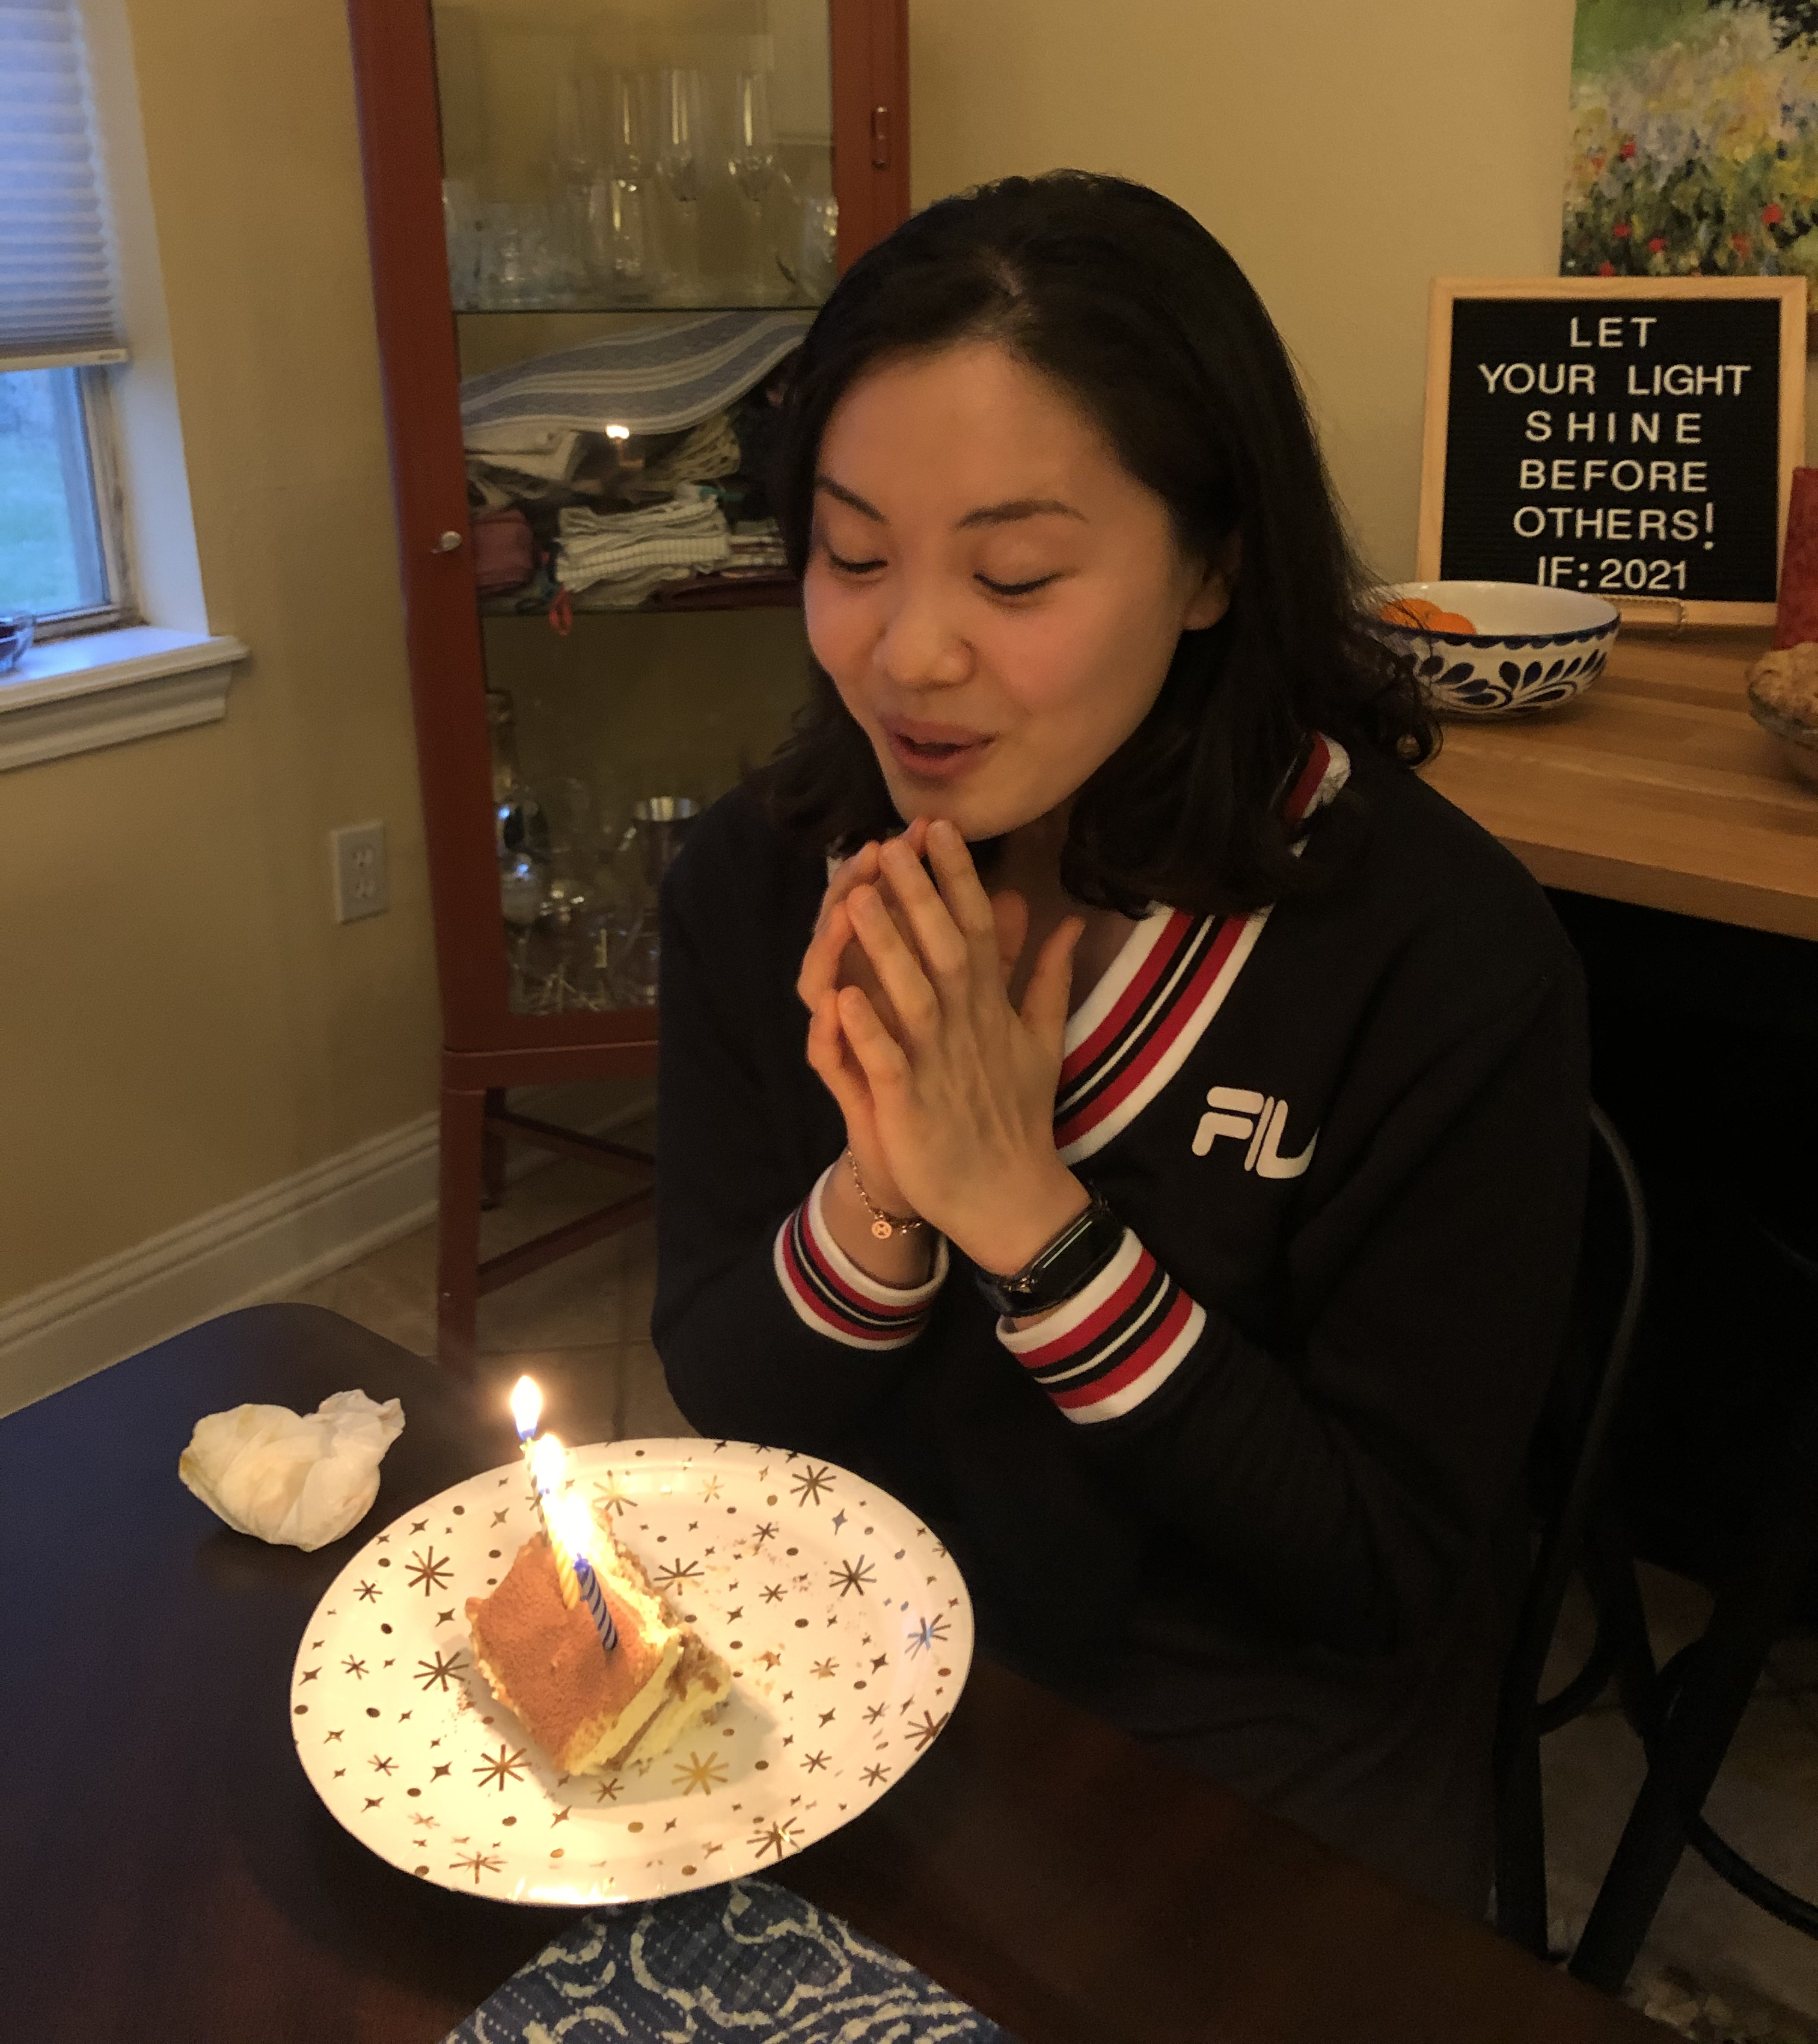
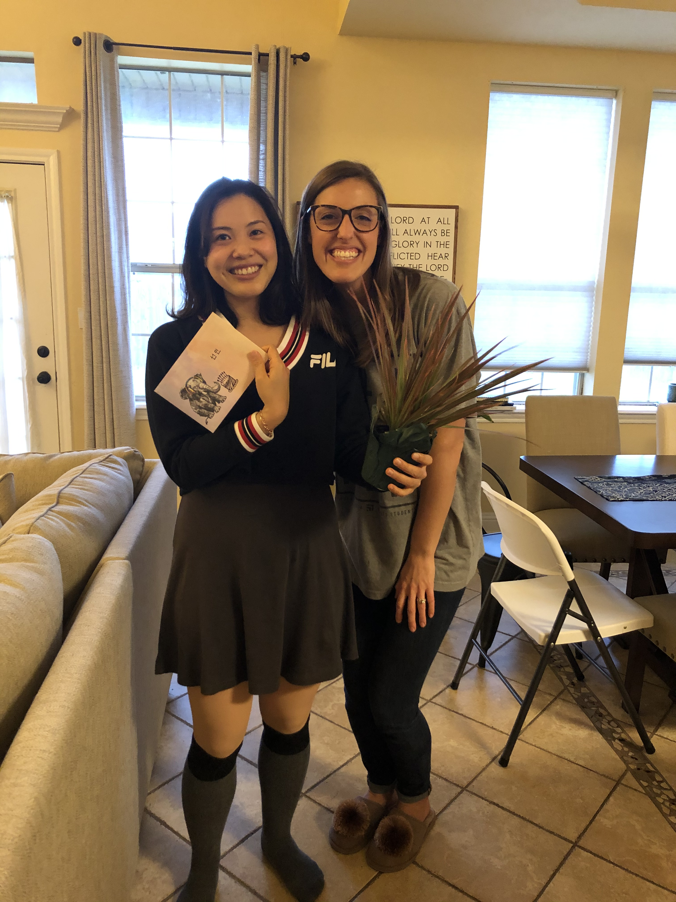
The gospel moves at the speed of relationships

Slide 9
Monthly Partnership opportunities
$500
$300
$200
$100
$75
$50
$25
Total: $2230/month

Slide 10
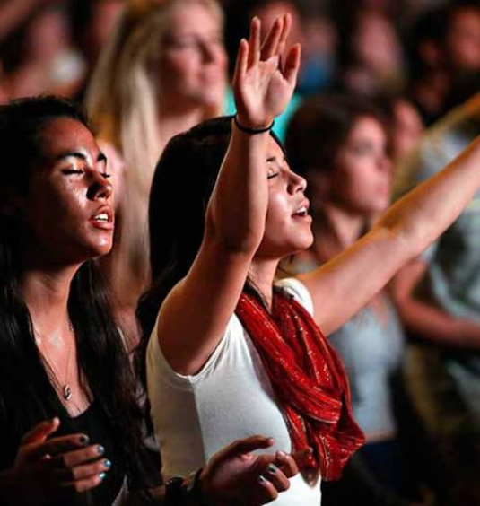
“Now to him who is able to do far more abundantly than all that we ask or think, according to the power at work within us, to him be glory in the church and in Christ Jesus throughout all generations, forever and ever. Amen.”
Ephesians 3:20-21

