Slide 1
The Heart of PD
It’s about the mission, not the money!
It’s about the giver, not the gift.
Notes:
0:06 Video moves to Gordy and Jeff on set
0:08 Jeff welcomes to ISI’s NSO video series!
0:15 Gordy introduces himself as ISI National Director of Training
0:20 Jeff introduces himself as National Director of Field Development
CLICK: It’s about the mission, not the money!
0:25 Gordy: The Heart of PD is mission! Our focus in this entire video series!!
CLICK: It’s about the giver, not the gift.
0:30 Jeff explains how Phil 4 is our biblical basis, especially 4:17
0:35 Display slide 3

Slide 2
Philippians 4:17
“Not that I seek the gift itself, but I seek for the profit which increases to your account.” [NASB]
Notes:
0:35 In Phil 4 Paul is thanking this church for their repeated support. We see this in Phil 4:10-16
0:45 Display slide 4

Slide 3
Philippians 4:10
“I rejoiced in the Lord greatly, that now at last you have revived your concern for me; indeed, you were concerned before, but you lacked opportunity.” [NASB]
Notes:
0:45 Jeff explains Phil 4:10; Paul rejoices in their most recent gift, knowing that they wanted to give but lacked opportunity
1:00 Display slide 5

Slide 4
Philippians 4:14
“You have done well to share with me in my affliction.” [NASB]
Notes:
1:00 Jeff: In 4:14 Paul commends the church for sharing in his affliction through their gifts
1:10 Display slide 6

Slide 5
Philippians 4:15
“You yourselves know, Philippians, that at the first preaching of the gospel, after I departed from Macedonia, no church shared with me in the matter of giving and receiving but you alone.” [NASB]
Notes:
1:10 Jeff: Paul reminds the Philippians of the uniqueness of their giving; they gave-Paul received
1:25 Display slide 7

Slide 6
Philippians 4:16
“Even in Thessalonica you sent a gift more than once for my needs.” [NASB]
Notes:
1:25 Jeff: Thessalonica was the next church Paul founded after he left Philippi (Acts 17), and the Philippians were already sending gifts for his support
1:40 Display slide 8

Slide 7
Philippians 4:17
“Not that I seek the gift itself, but I seek for the profit which increases to your account.” [NASB]
Notes:
1:40 Jeff: Paul was thankful for the Philippians’ gifts. But in v. 17 he wanted to clarify that not even his thanksgiving should be interpreted as a desire for more gifts. Rather what Paul really sought was growth in the Philippians.
1:50 Display slide 9

Slide 8
Philippians 4:17
“Not that I seek the gift itself, but I seek for the profit which increases to your account.” [NASB]
Paraphrase: Don’t misunderstand, Philippians, my desire is not for your gifts, but rather for great spiritual dividends in the lives of those who give.
Notes:
1:50 This paraphrase captures what Paul wanted to convey to the Philippians (read).
2:00 Display slide 10

Slide 9
Philippians 4:17
Key idea: What motivated the Apostle Paul in receiving gifts from his supporters was their spiritual growth.
Notes:
2:00 Paul’s key idea moves PD from gifts to givers
2:10 Display slide 11

Slide 10
Biblical Partnership Development
Biblical PD is prayerfully asking people to help meet the financial needs of our ministry for the sake of their growth into Kingdom partners.
Notes:
2:10 Jeff summarizes thus far with content of slide 11
-We can’t win/disciple international students alone
-We need a team of supporters to join us
-As they do, they enter into mission with us
2:20 Display slide 12

Slide 11
Biblical Partnership Development
Biblical support development seeks partners who will join us financially – in order to help fulfill the Great Commission!
Notes:
2:20 Gordy talks through the concept on slide 12
- bottom line, PD is about discipleship
7:20 Display slide 13

Slide 12
Biblical Partnership Development
Partnership development is all about DISCIPLESHIP:
Engaging God’s people in God’s global redemptive mission
Individual believers (redemptive purpose, eternal rewards)
The Church (from myopic missional focus to global missional vision)
Over past decades…global to local
Missional (GC) to experiential
ISI = both local AND global!
Notes:
7:20 Gordy and Jeff both affirm the concept of PD as mission
- PD is about discipleship (believers; the church)
- Believers (redemptive purpose; eternal treasure)
- Church (parochial/myopic to global/larger scope)
8:00 Display slide 14

Slide 13
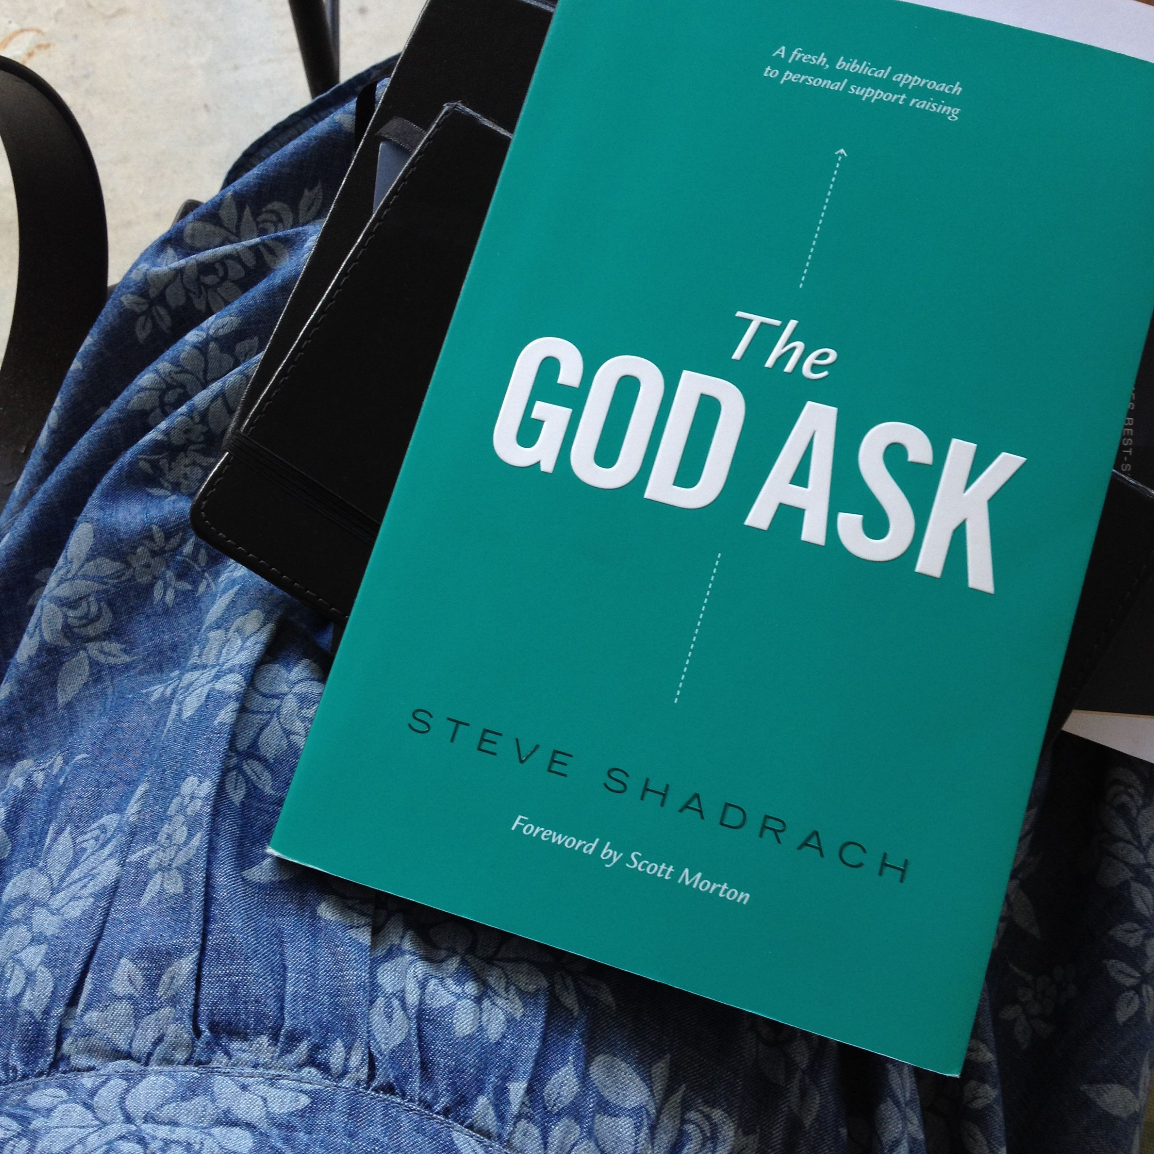
Our guiding text is God’s Word, but we also employ Steve Shadrach’s book,
The God Ask.
Notes:
8:00 Jeff talks about The God Ask and calls attention to Steve Shadrach’s comment on p. 84
-We have chosen to use The God Ask as our text
-We did so not because we promote all the ideas therein
-Rather we did so because it is the best, most up-to-date text available
-The book is full of excellent, practical ideas on PD
9:00 Display slide 15

Slide 14
“What if you were to start viewing yourself as a mobilizer? Not just moving people’s finances from one bank to another but moving their hearts from a temporal focus to an eternal one.”
Steve Shadrach
The God Ask (p. 84)
Notes:
9:00 Wrap-up:
-Jeff: Steve Shadrach has it exactly right…(see slide 15)
-Gordy: the ISI approach to support development enlists supporters in the broader work of the Harvest
and changes how we look at PD from the inside out
-Jeff: as you talk to people about support, remember you are there to minister to THEM, because PD is about the giver not the gift
9:30 END

