Slide 1
ISI Donor Services
All things related to donors and processing support
goes through Donor Services.
Think of us as MONEY IN,
Finance is MONEY OUT!

Slide 2
About us:
Bre Haven – Donor Services Coordinator
Serving ISI since 2015
In the Income Processing field for over 15 years

Slide 3
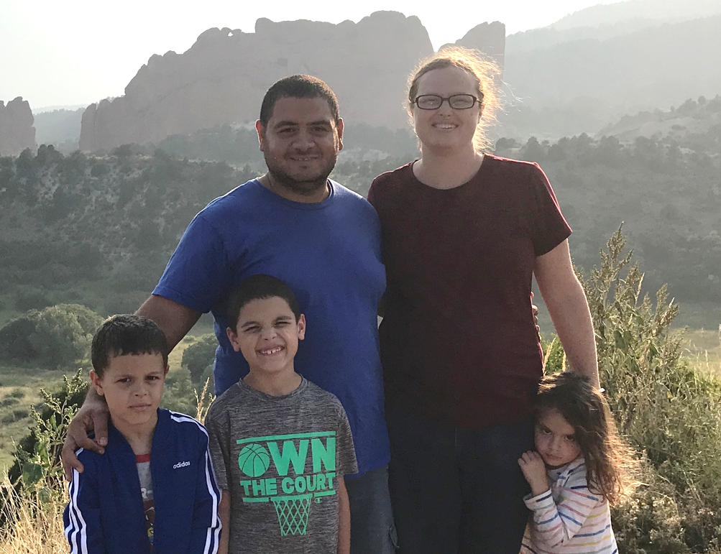
About us:
Emily Barakat– Donor Services Representative
Serving ISI since 2022
Served internationally with YWAM in countries like Malaysia, Iraq and many more for several years.

Slide 4
You’ve got supporters, so how do they give?
Donors can give via:
Checks
Credit Card
Automatic Bank Draft
Through Foundations and Retirement Accounts
Gifts-in-Kind
Stock Gifts

Slide 5
Check Donations
Provide your unique 4-digit project number to any prospective donors! This is how we ensure a gift is credited to the ISI account assigned to you.
Checks must be made payable to ISI.
Checks made payable to staff then forwarded to our office will be returned to the donor for proper addressing
Checks payable to staff members, endorsed with “pay to the order of ISI” are considered donations from the original recipient/staff member. Because you cannot self-fund your own account, we cannot process these gifts.
No cash! If you receive cash from a donor, please obtain a money order with the donor’s information as payee.
Check donations generate a receipt for remittance of next gift. Pre-addressed envelope included.
We do not process pledges. No monthly statement is mailed to donors, only a receipt per check.
All donations processed are assessed SSA fee of 5%-25%. (See separate brochure explaining SSA)

Slide 6
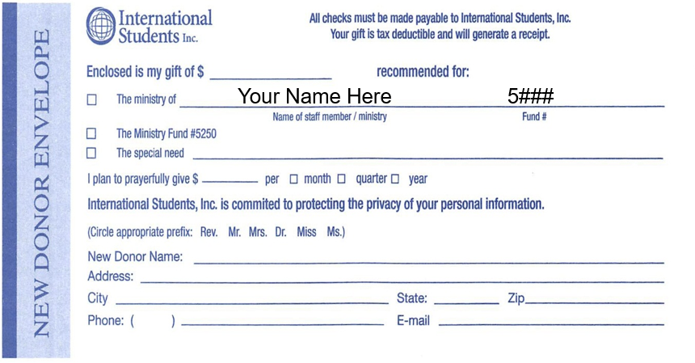
New Donor Envelopes
New donor envelopes provided in welcome box
Distribute to potential new donors only
Be sure your name and project number are pre-filled on any envelopes you hand out
Email scans of envelopes from check supporters who intend monthly contributions will be sent to you directly.

Slide 7
Receipts
Receipts are mailed out within 72 hours of checks being processed.
Donors can request emailed receipt, or no receipt be sent.
Bottom section is perforated to tear off and include with next gift in the pre-addressed envelope.
Reprints are available any time by request.
We also include a monthly insert with receipts. Prayer cards, ministry updates, encouraging electronic giving, etc.

Slide 8
Online Giving
Donors can give online via credit card or bank draft.
One-time gifts and recurring gift options available.
Emailed receipts are generated for all online transactions.
Staff see online gifts the following business day once a donor gives.
Recurring donors
Option to give weekly, monthly, quarterly, or annually
Emailed notifications of any declined transactions are sent to donors.
Donors can register their email address for online access to their account information.
Assistance is available by calling Donor Services at
800-474-8628.

Slide 9
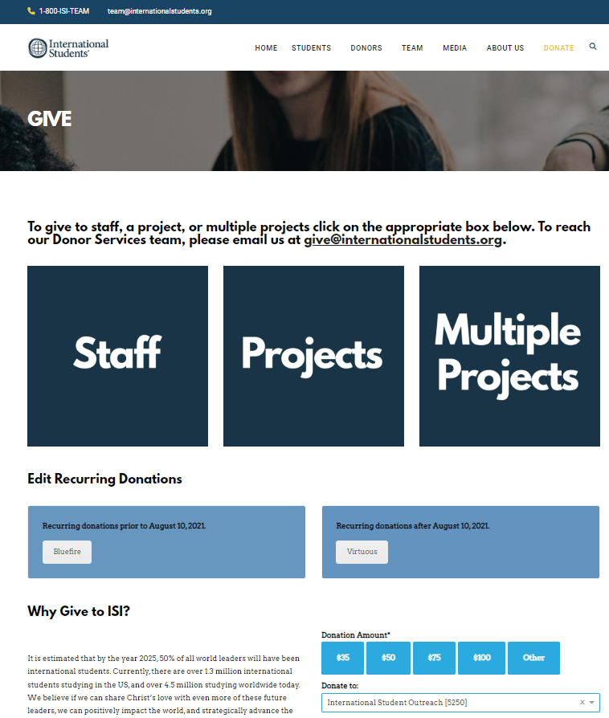
Your Direct Donation Link:
Provide your direct donation link to prospective donors
Visit: internationalstudents.org/give
Click “Donate”
Click “Staff” box. (Page defaults to our national ministry fund so this step is important.)
Use search box to find staff member. If misspelled no result will be found.
Click “Read More” under staff’s name
URL that results is your direct donation link.

Slide 10
Other Types of Giving
Gifts made through Foundations or Retirement accounts will result in donor information showing as “Pass-Through.”
We accept stock gifts. Donors can request information by emailing give@internationalstudents.org.
Canadian donors – Sister organization, ISMC, will process donations of supporters in Canada for receipting purposes. In order to accept donations for ISI staff, ISMC must obtain board approval. Please let us know as soon as possible if you wish to receive donations through ISMC.
International donors – If donors overseas have a universal credit card, they should have no problems giving online. If not available, we can discuss bank-to-bank transfers. Subject to bank fees and processing delays.

Slide 11
Other Types of Giving
Gifts-in-Kind are when a donor provides donated goods. Request a receipt for items by emailing Christine Holland at cholland@isionline.org with description of items and donor’s information.
Honorariums – If you receive an honorarium for a speaking engagement, funds will be processed as miscellaneous income with no SSA taken.
Vehicle donations are NOT accepted due to IRS regulations.
Special accounts can be established to fundraise for expenses not covered under your budget with your standard ministry fund. For example, overseas travel to visit returnees.
Please contact Finance regarding fundraising through special accounts. A 10% SSA assessed on special account donations.

Slide 12
Accessing Donation Information via Virtuous
View training materials online at: https://donorservicesisi.weebly.com/virtuous-giving.html
Contact Donor Services at give@internationalstudents.org to gain your individual access.

Slide 13
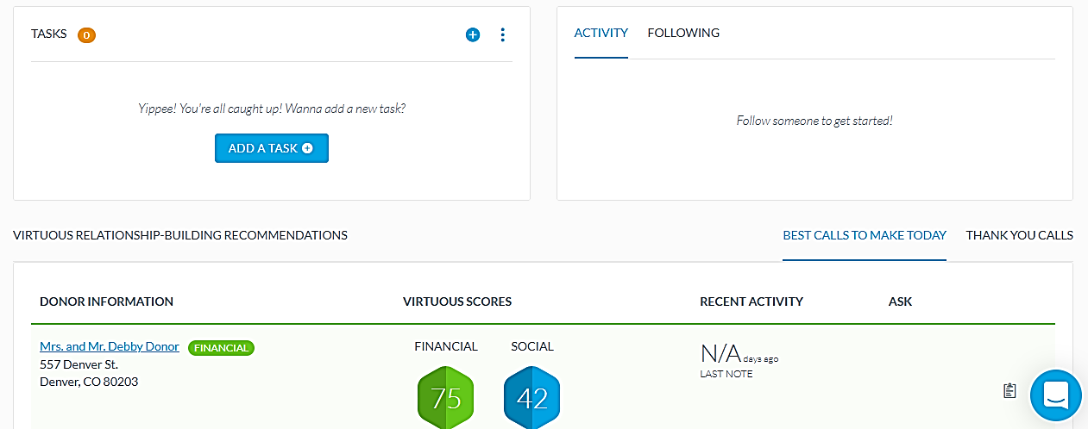
What can you see on Virtuous?
Dashboard contains widgets for recent gifts posted.
Use 13-month donor health report for seeing new donors, recurring donors and track supporters giving.
Track monthly progress for your budget goal.
Create tasks for yourself to follow up with donors or send thank you letters.

Slide 14
View Contact Records
You can view contact records for your donors.
Prospective donors can be added to Virtuous as well. Please contact Donor Services for assistance with adding these individuals.
Review address and email information
Review gift history
See recurring gift information
Contact Donor Services for assistance in navigating
800-474-8628

