Slide 1
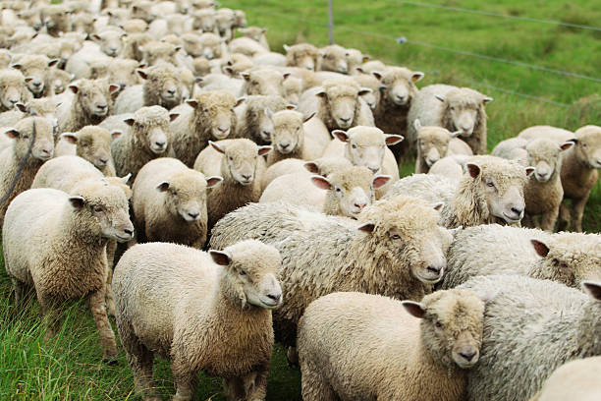
STEP 10: Donor Care
Nurturing your flock

Slide 2
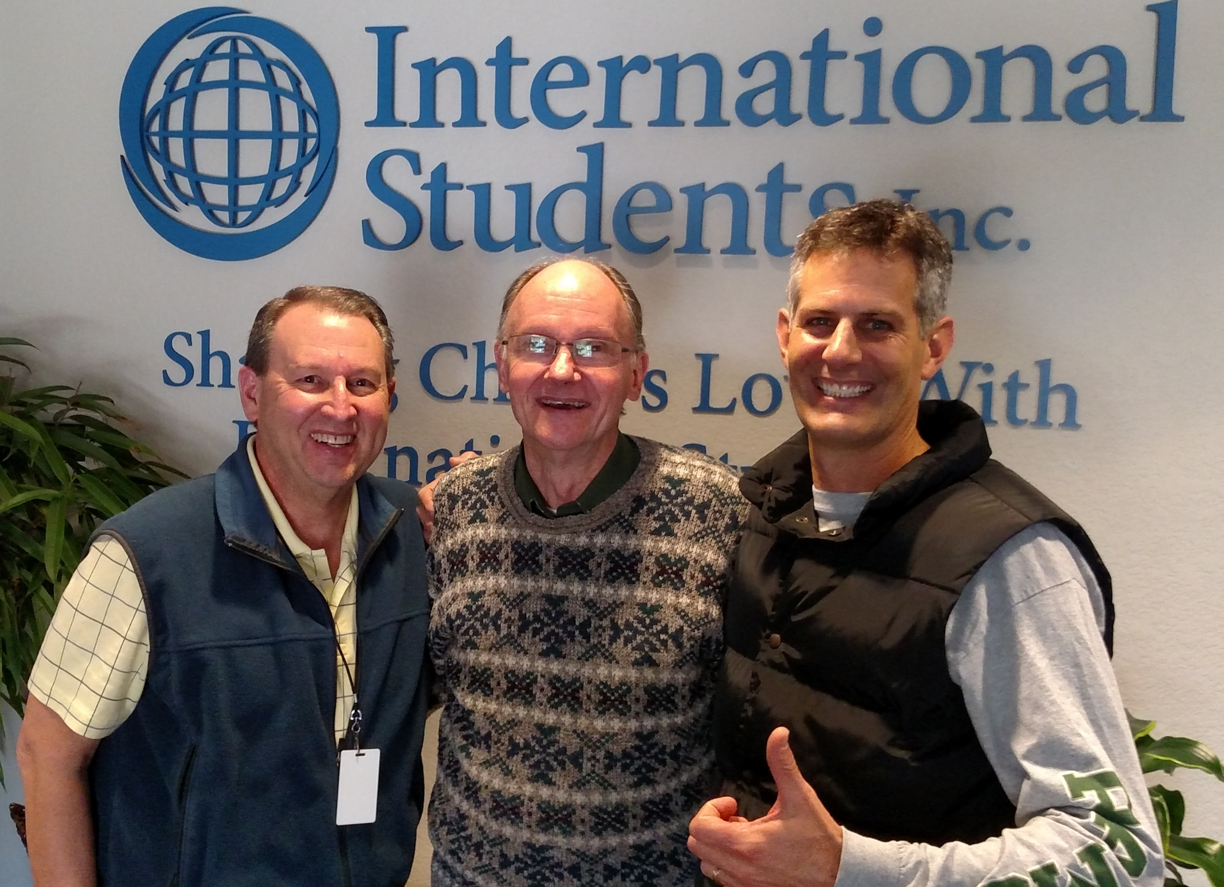
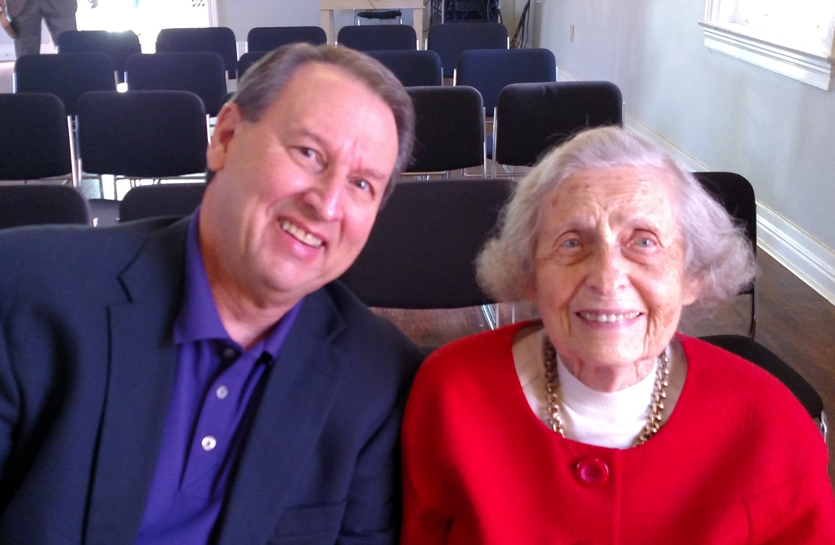
Get to know them (record in your record-keeping tool)
Their preferred names
Birthdays and anniversary
Children’s names and birthdays
Pets and their names
Other unique details and preferences.

Slide 3
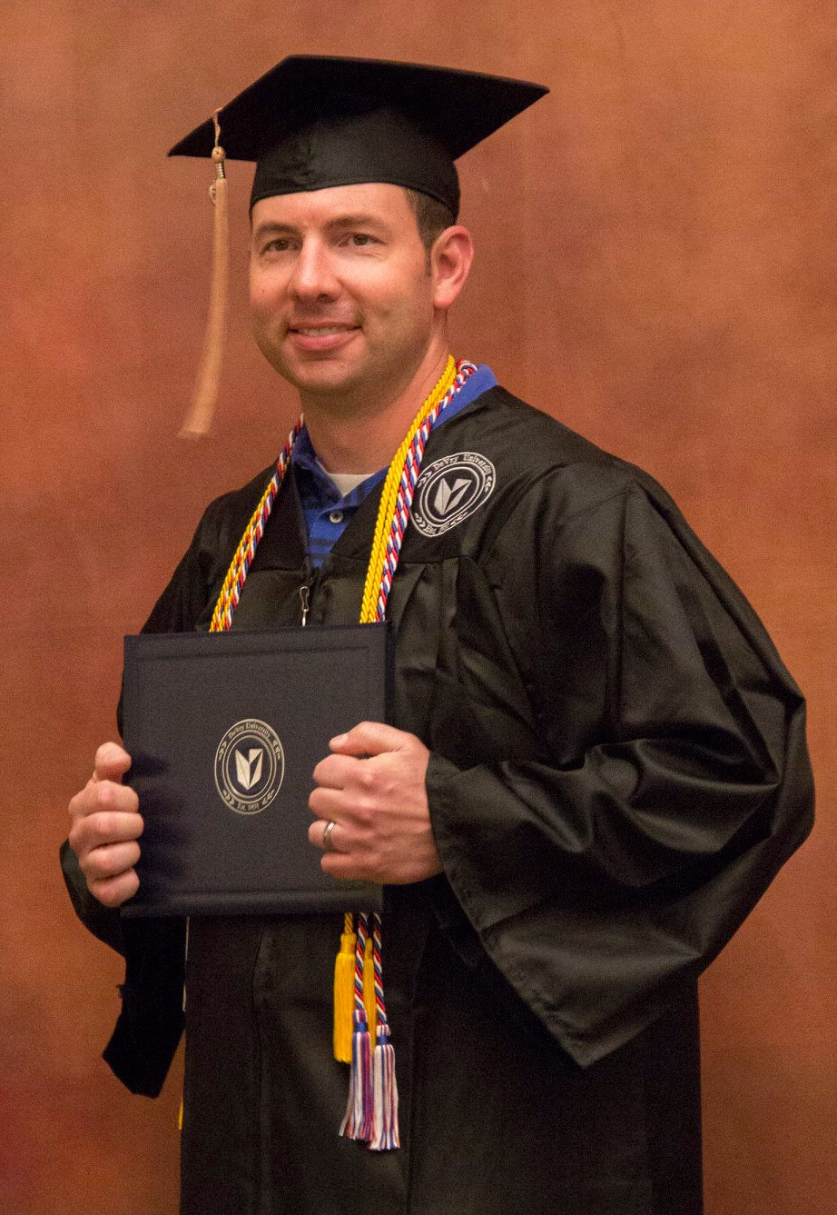
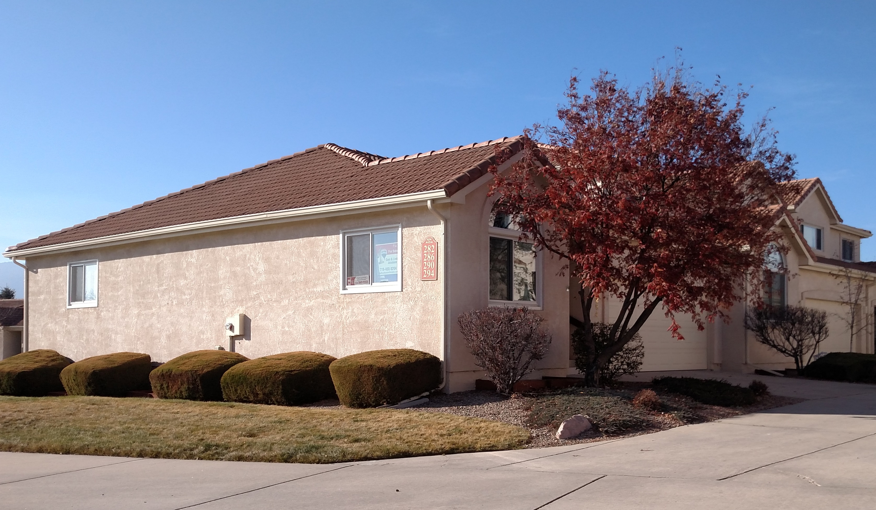
Correspond with them
Regular updates on ministry; prayer needs
Births; birthdays
Wedding; wedding anniversary
Children’s birthdays
Significant accomplishments; events
Important dates.

Slide 4
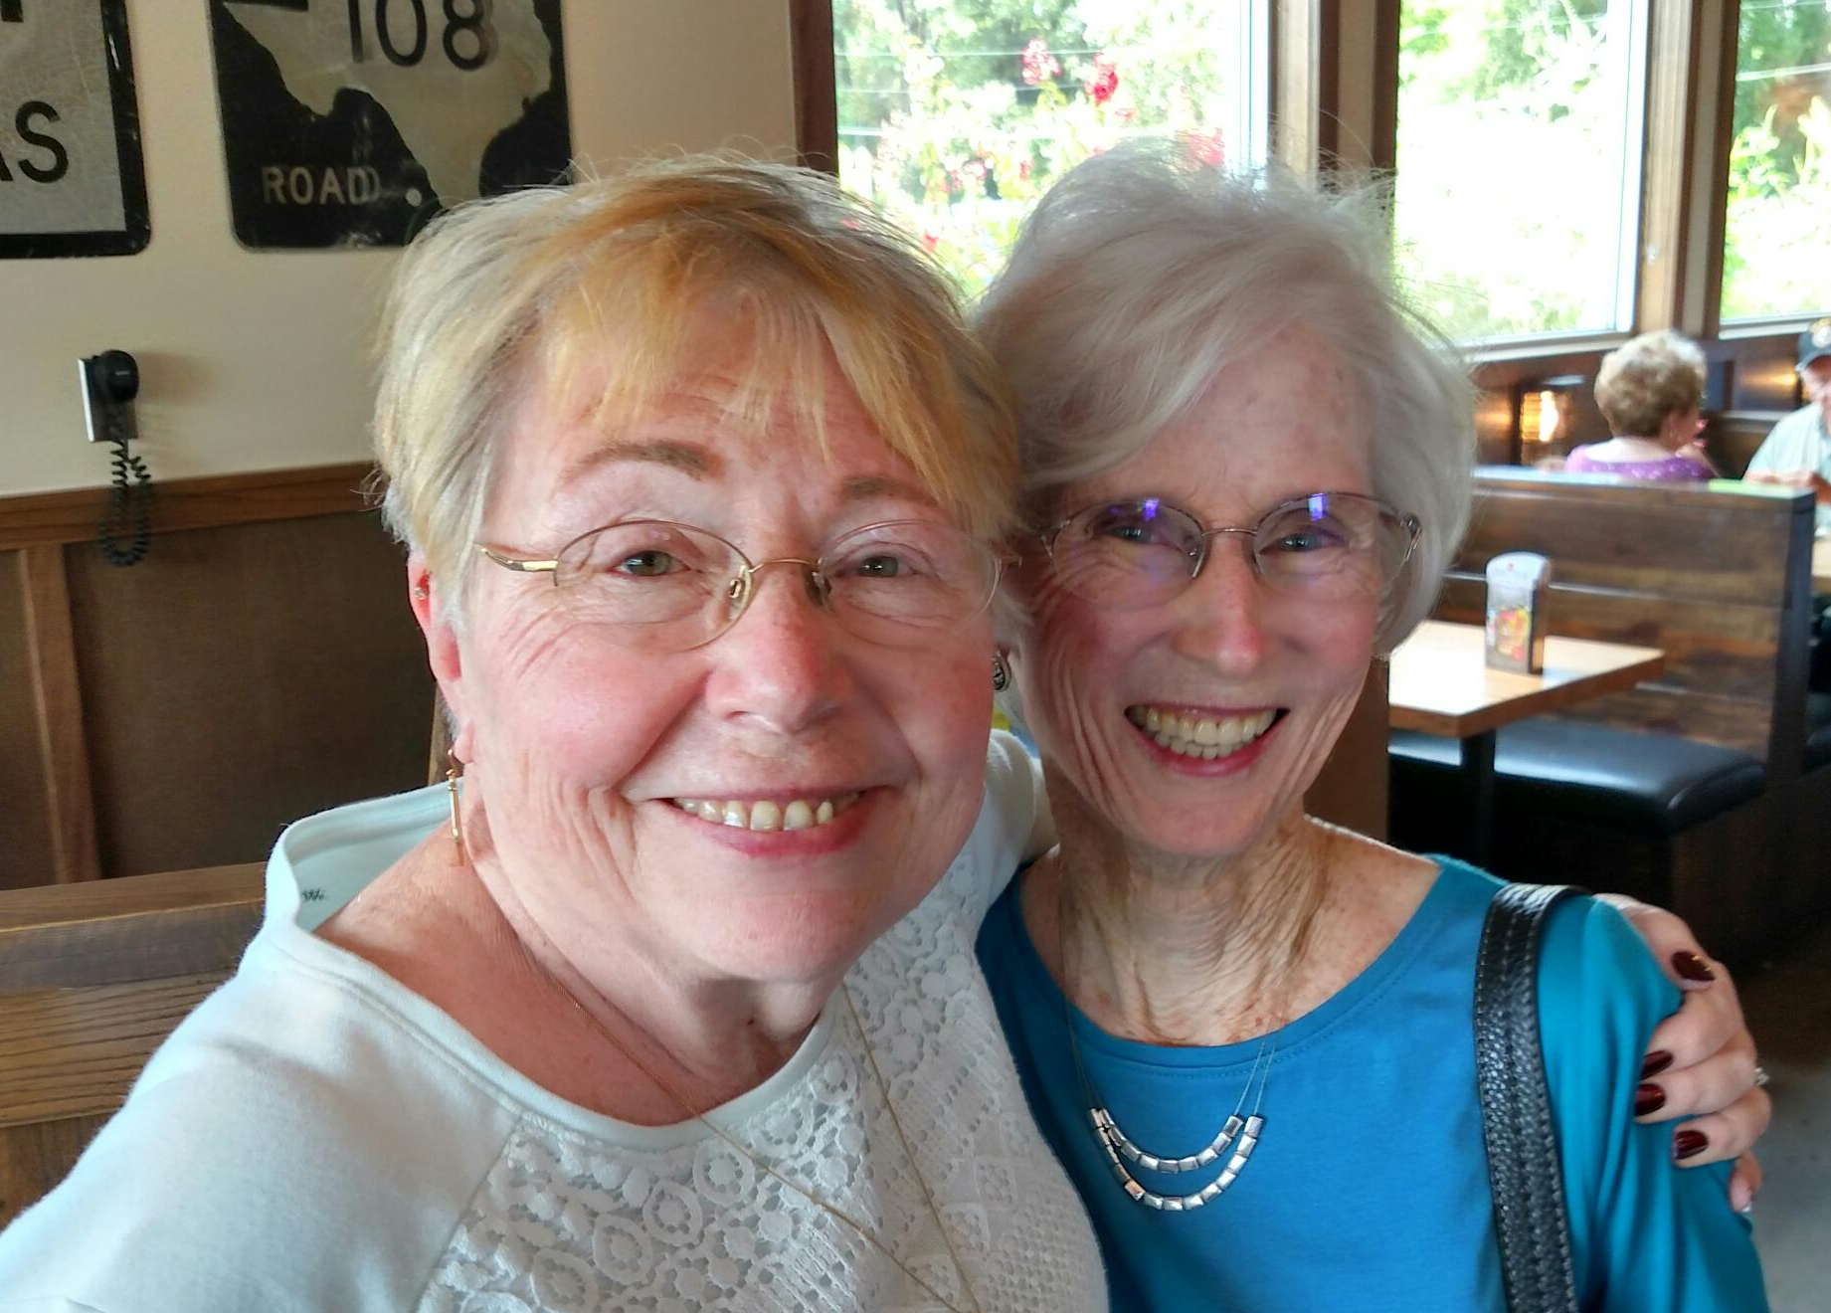
Meet/Visit them
Meet regularly with local supporters
Regularly plan PD travels to more distant supporters
Build in ‘ask’ visits on your travels
Be sure to leave your latest promotional materials
Keep records of all meetings/visits
Build in vacation time.
www.creativeplus.com

Slide 5
Involve them
Pikes Peak Area Wild West Welcome

Slide 6
Thank them
It’s always nice to do this via mailed, hand-written card.
Every once in a while, a small gift is appropriate.
I always leave a gift on PD travels.
Christianbook.com is a good resource for gifts.
Be sure to record gifts given.

