Slide 1
DISC in PD

Slide 2
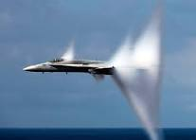
Know Your Audience
It’s not about US. It’s about THEM.
“Match the hatch!”
Breaking the “sound barrier.”
YOUR filter—”sound barrier”—THEIR filter
DiSC is your “filter eliminator.”

Slide 11
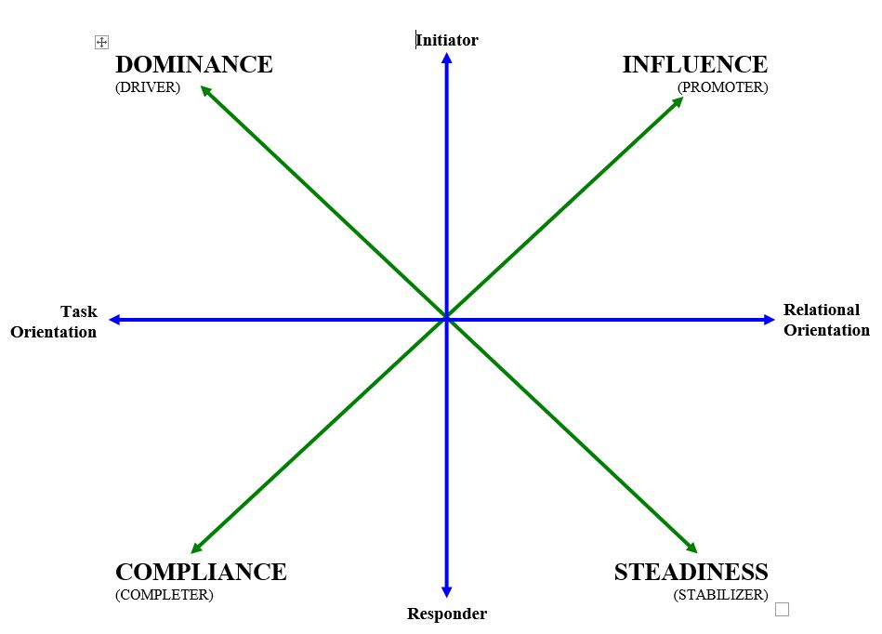
DISC Patterns
Notes:
Another way of picturing our interpersonal and/or work styles is using this graph with X and Y axes. As you can see…

Slide 12
DISC Patterns
Notes:
Each of us is a blend of two or more personality types and therefore display varying levels of characteristics depending on the mix and strength of our styles, as well as the different environments we may find ourselves. But typically, most people have one dominant and one secondary style which serves to balance out the extremes of any one personality type.

Slide 13
1Corinthians 12
1 Now concerning spiritual gifts, brethren, I do not want you to be unaware…
4 Now there are varieties of gifts, but the same Spirit. 5 And there are varieties of ministries, and the same Lord. 6 There are varieties of effects, but the same God who works all things in all persons. 7 But to each one is given the manifestation of the Spirit for the common good.

Slide 14
One BODY.

