Slide 1
Due to Animation, best viewed in PRESENTATION MODE

Slide 2
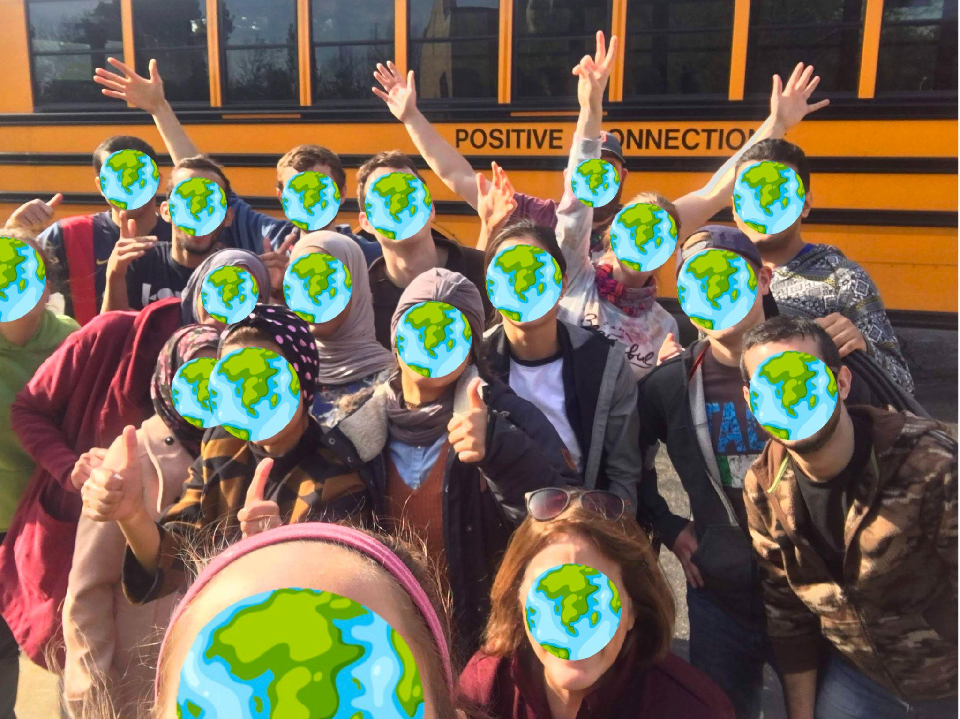
International Student Inc.
Serving International Students in Dallas, TX

Slide 3
What will we talk about?
Big Picture
My Role
How can you take part?

Slide 4
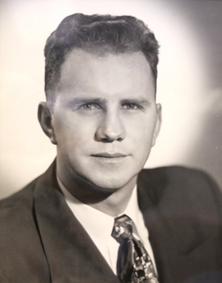
What is ISI?
Why does ISI exist?
International Student Inc., or ISI, is an International student ministry on varying college campuses in North America.
Mission Statement:
ISI exists to share Christ’s love with International students and to equip them for effective service in cooperation with the local church and others.
Bob Finley
Notes:
Super Basic what is ISI?
Again, basic, Why does ISI exist?
Those are a lot of words, so let’s break that down a bit
In 1951, Dawson Trotman, founder of The Navigators, spoke with Bob Finley about an outreach to foreign students arriving to study in the US.
And soon after, others joined Bob in founding ISI in 1953
So, what captivated Bob Finley to the point where he founded and committed his life to International Students in the US?
Well, He saw something.

Slide 5
Matthew 28:19-20
Go therefore and make disciples of all nations, baptizing them in the name of the Father and of the Son and of the Holy Spirit, teaching them to observe all that I have commanded you. And behold, I am with you always, to the end of the age.
Matthew 28:19-20
Go therefore and make disciples of all nations, baptizing them in the name of the Father and of the Son and of the Holy Spirit, teaching them to observe all that I have commanded you. And behold, I am with you always, to the end of the age.
Notes:
Matthew 28:19-20, you probably could quote it by heart.
READ IT
I know you know this verse and have thought a lot about it.
What are some key words and themes in this passage, just name them off…
Go, go where? To the nations
This is the passage that God used to call me to Unreached peoples and this is the passage He continues to use as I go throughout my life.

Slide 6
Romans 10:13-15
For ‘Everyone who calls on the name of the Lord will be saved.’
How then will they call on him in whom they have not believed? And how are they to believe in him of whom they have never heard? And how are they to hear without someone preaching? And how are they to preach unless they are sent?
Psalm 86:9
All the nations you have made shall come
and worship before you, O Lord,
and shall glorify your name.
-John Piper
Notes:
Romans 10:13-15
For “everyone who calls on the name of the Lord will be saved.”
How then will they call on him in whom they have not believed? And how are they to believe in him of whom they have never heard? And how are they to hear without someone preaching? And how are they to preach unless they are sent?
There is a lot to say in that passage, but I think John Piper sums it up well.
READ IT
We are to go to the nations and share the good news of Christ and God has given us the privilege to be apart of what He is doing in
Psalm 86:9
All the nations you have made shall come
and worship before you, O Lord,
and shall glorify your name.
That is going to happen
And I believe Bob Finley saw that. This command to make disciples of all nations, and the exposure he was given by Dawson Trotman made him look around his own backyard.

Slide 7
Notes:
I want you to take a look at these people, pay attention to where they are from and what positions they are in
Pause for 10 secs
READ

Slide 8
Notes:
READ THE TITLE
Pause
It’s very Humbling to think that God is giving us this kind of opportunity here in the states.
Any questions?

Slide 9
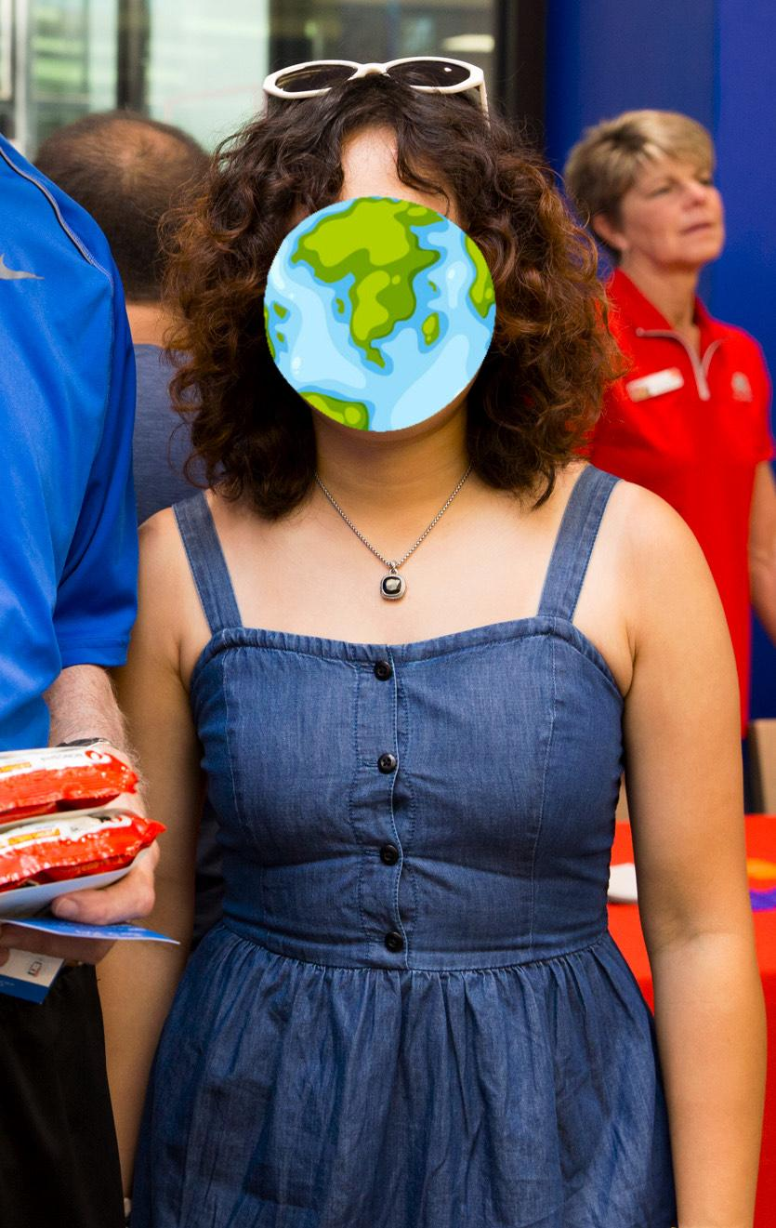
Facts about International Students
Hard to assimilate
Loneliness
Intelligent
Rich cultural background
Open minded
Plans to return back home
Notes:
There is this need to make disciples of all nations and then we see a little more than 1 million International Students coming to the US to study.
And they have a lot of needs
-Hard for international students to assimilate
-moving to a new country, different language, transportation, grocery shopping, medical system
-Lonliness, just last year we had 2 International students at a campus up the street commit suicide. I had a student just last week tell me that she has to call the suicide hotline once a month. Just like we need community they need community
Those are two very difficult things that International students have to live with, but they are also,
-Extremely intelligent
-They come from such rich cultures that display their creator God in unique ways
-For the most part they come with an open mind to the culture around them.
-And most of them have plans to return back home, and this is a key part of ISI. I’ll explain in a moment but first meet Cynthia
She became a christian in Beijing and came to Texas to study. She is pursuing counseling and wants to use her degree to impact others and share Christ. God has made Cynthia chinese which means she can do things that we can’t. Cynthia can reach people with gospel that we simply do not have access to. And Praise God
Any questions
With some students this will be their first exposure to the Gospel and we may labor the whole time we are with them to see a changed heart for Jesus. With Cynthia we want to come alongside her, be a part of her discipleship as she goes and makes disciples.

Slide 10
Notes:
But with both students this is our Goal…
READ IT
I really do believe the possibilities are endless here. God has given us each unique abilities and gifts to use to make disciples for his glory. One of the women that I am working with loves the Ukulele and she uses that for discipleship by offering free lessons to students, and she has created a bible study and discussion around ukulele.

Slide 11
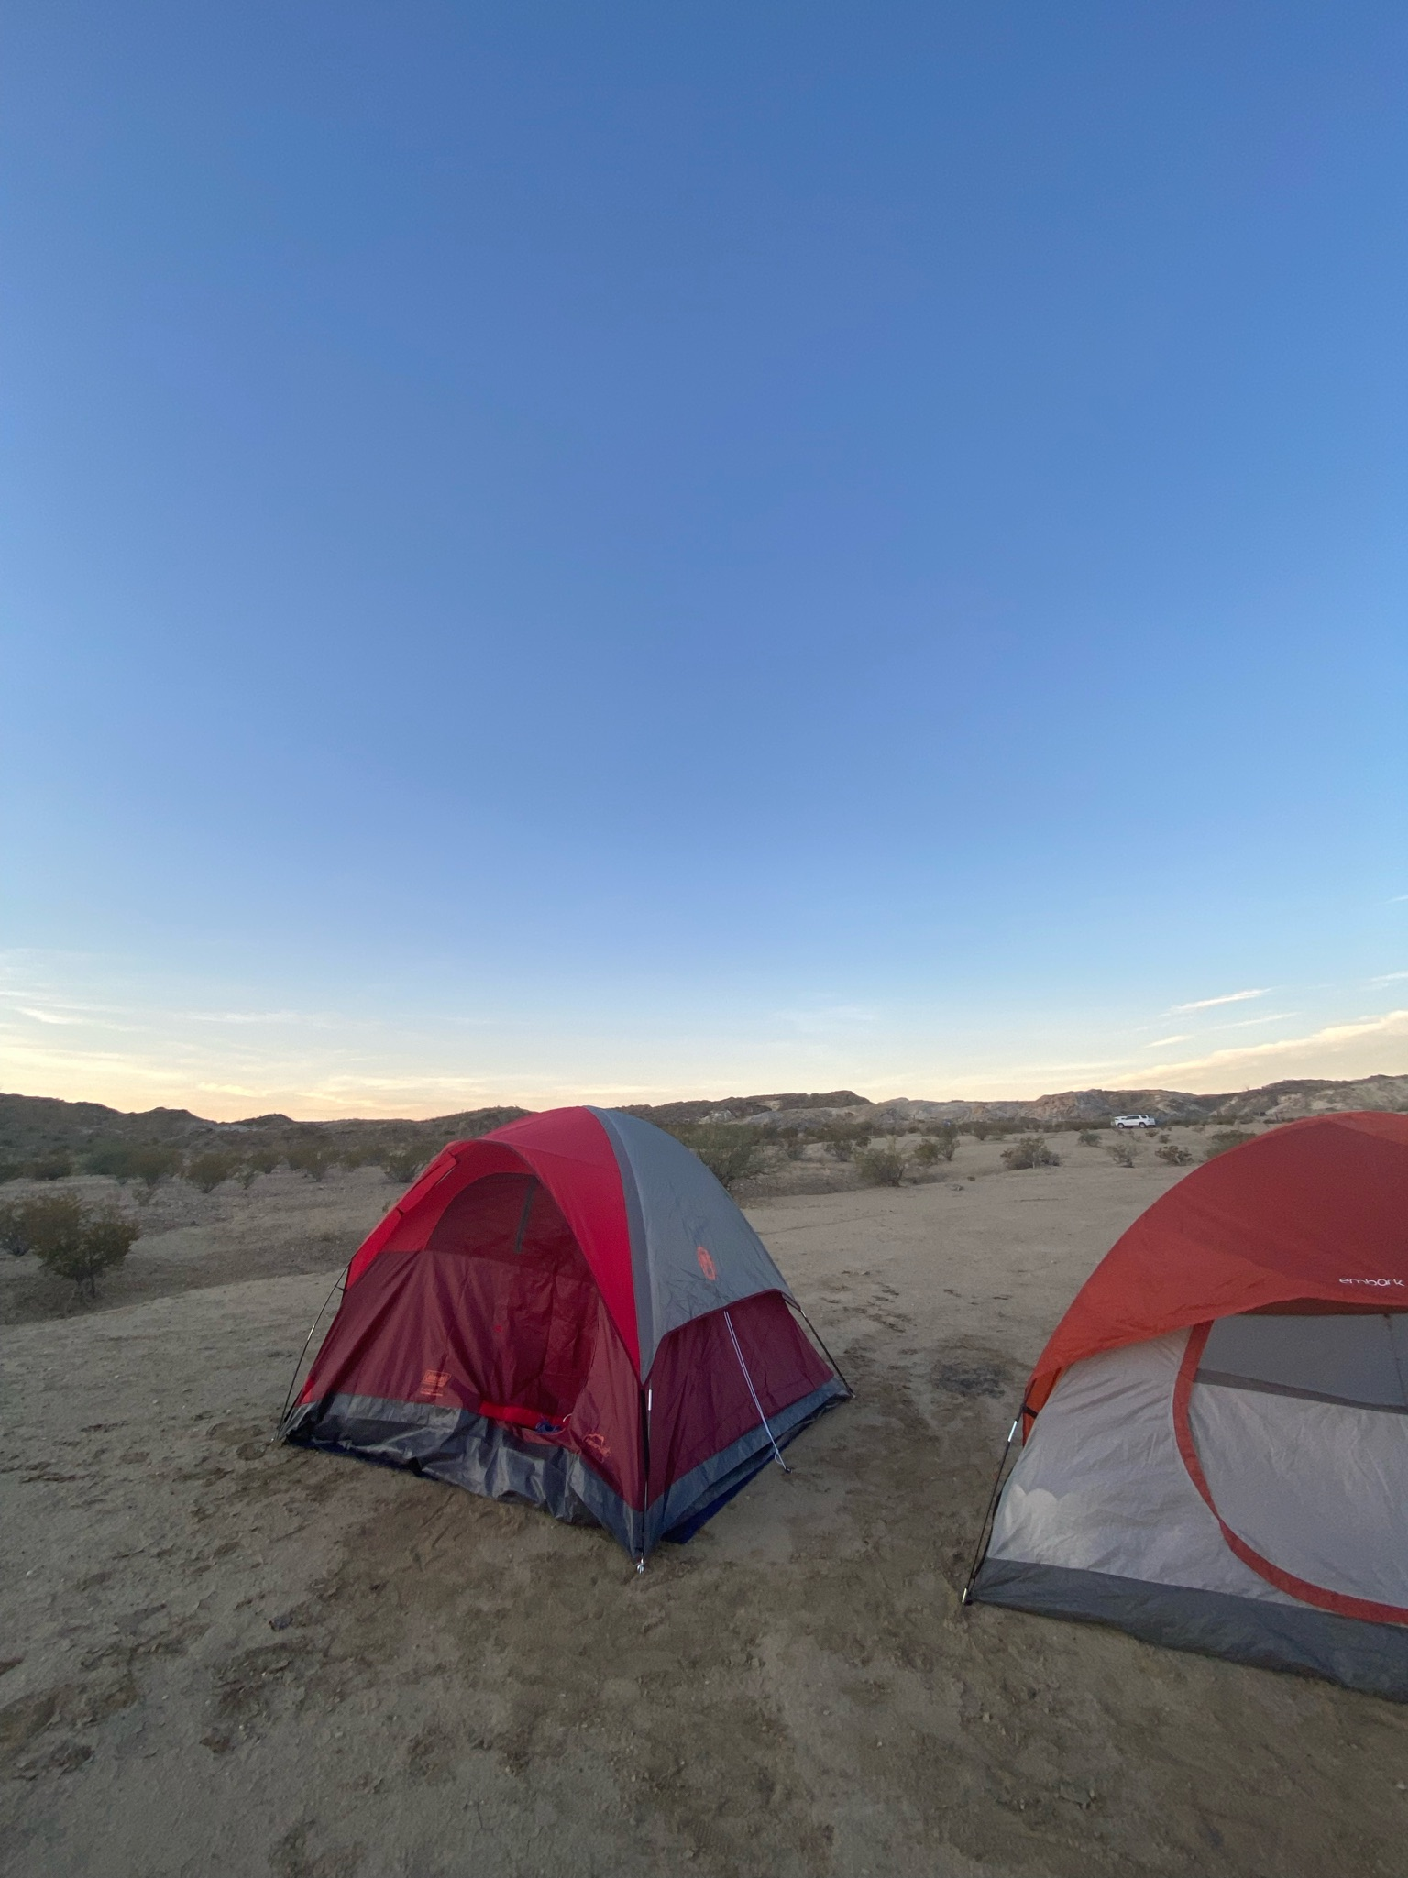
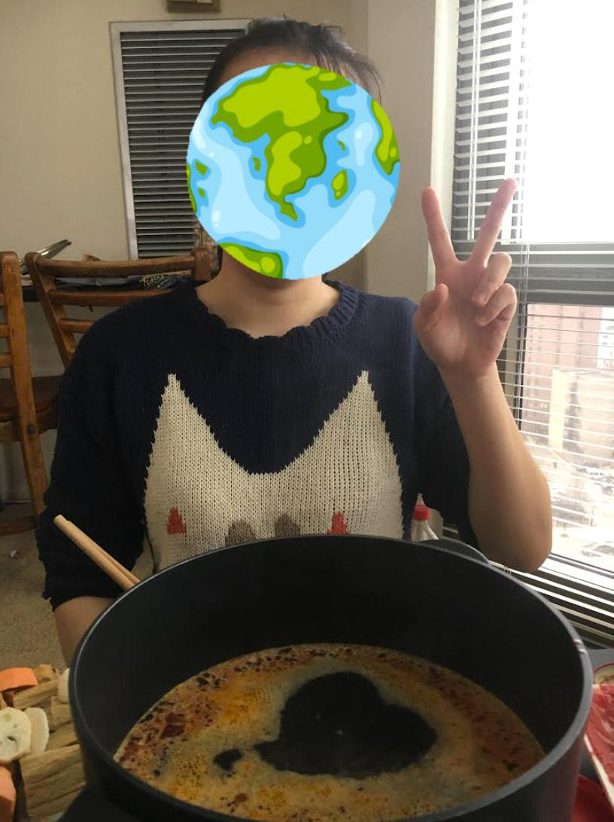
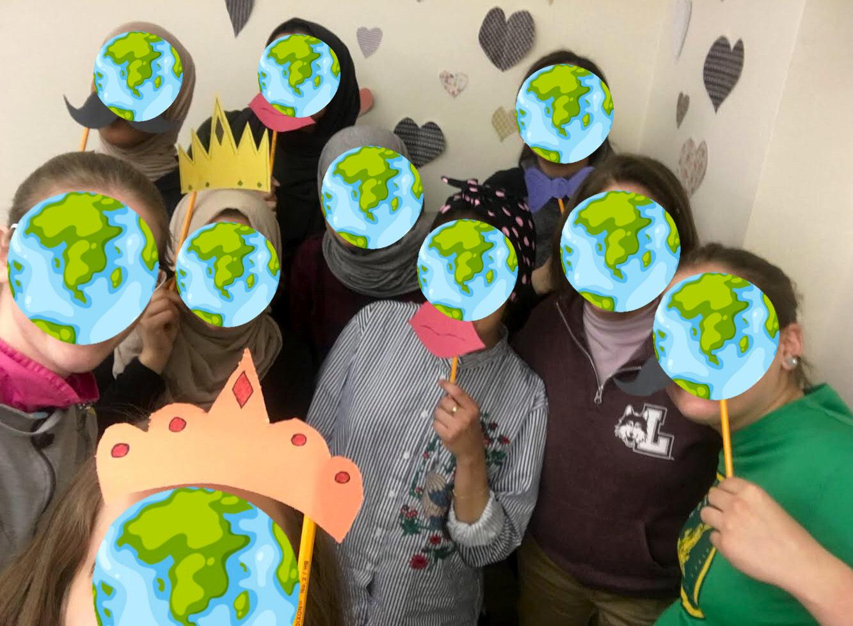
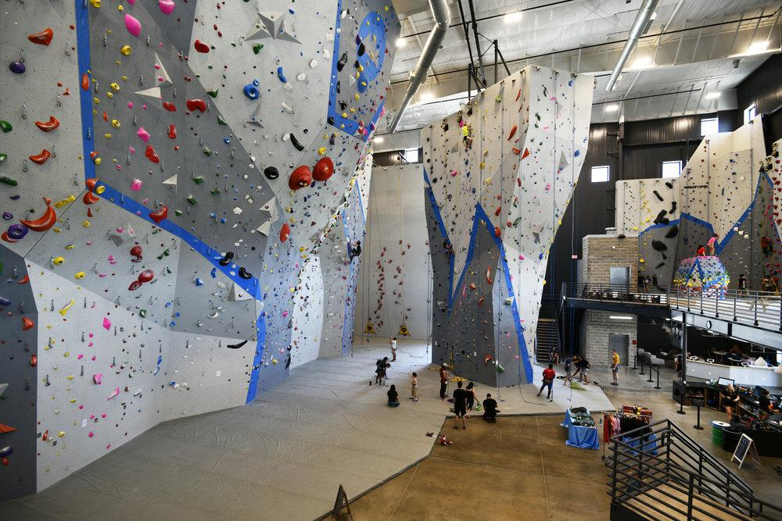
What will I be doing?
Notes:
So how do we go about making disciples who make disciples
Big Group Events, like movies and discussion, women’s tea, dinners
One on one discipleship
Weekly Bible Studies
Girl’s climbing group
Yearly retreats and campouts
And again everything that we do is aimed at making disciples who then can go back to their home countries and make disciples. The nations are here, and I want to hear them sing to the one who created them.

Slide 12
Notes:
I cannot do this alone, I need a team of people surrounding me.

Slide 13
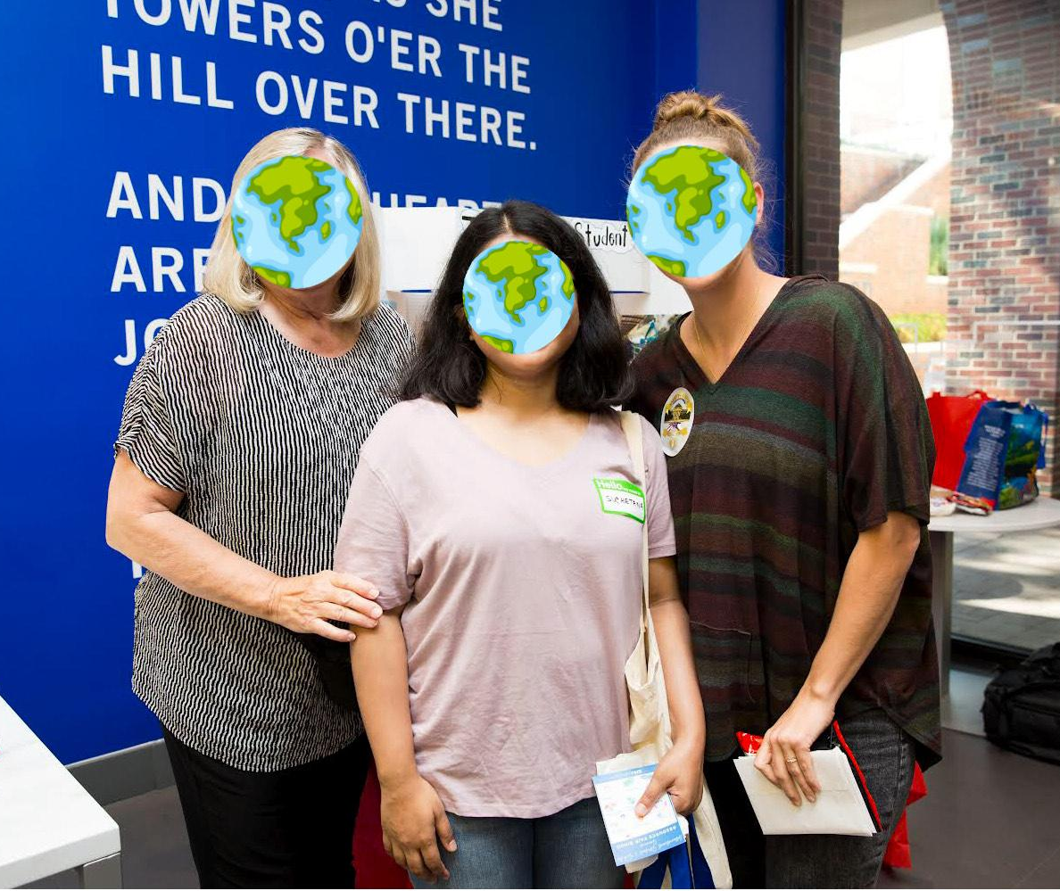
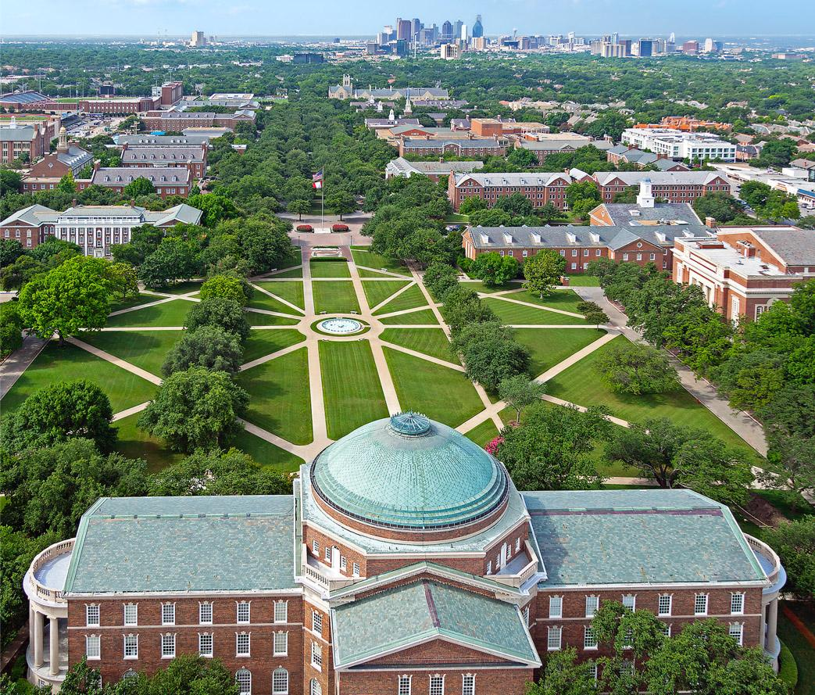
With Who and Where?

Slide 14
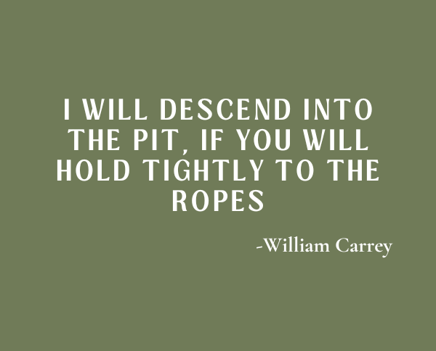
How can you get involved?
I need a strong financial support team
$200
$150
$100
$50
$25
Notes:
But I need more than just fellow campus staff, and this is where you come in
William Carrey, a missionary from India told his friends before departing, READ IT
God has given me a prayer team, which I am so blessed and encouraged by.
But I am needing a financial team and it would be an honor for me if you would prayerfully consider joining me in what God is doing by giving a monthly financial gift.
…
Thank you so much for your time!

